Slide 1
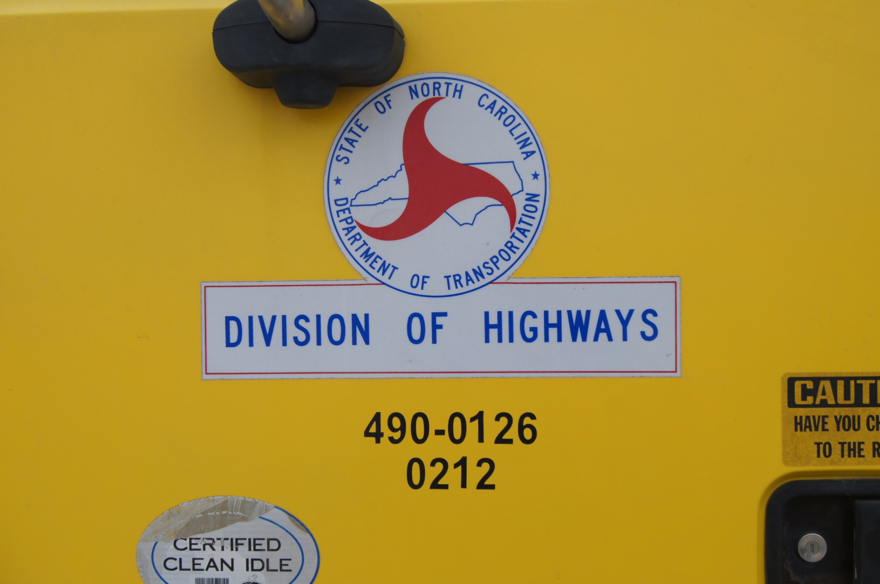
Pre – Trip Inspection

Slide 2
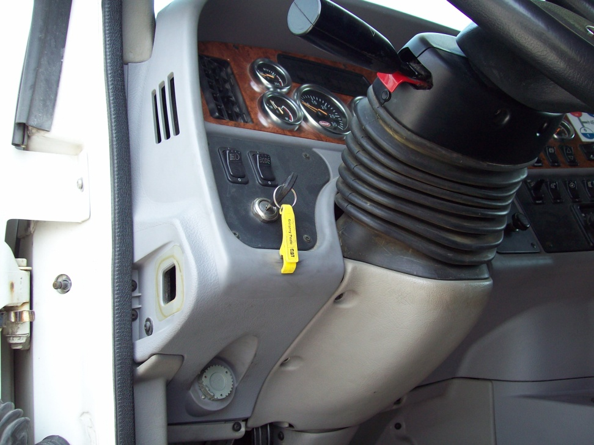
Step # 1
Remove Key

Slide 3
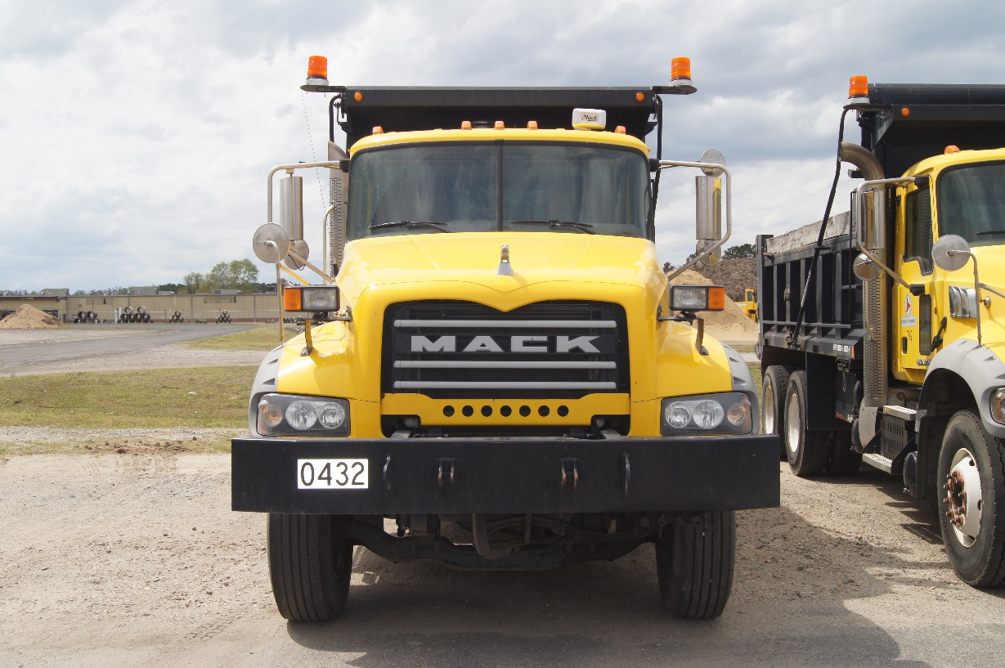
Step # 2
We start the Pre – Trip Inspection using a sequence such as Top – to - Bottom , Left – to – Right , Right – to – Left , or Inside – to – Outside .
Pre – Trip Inspection covers all the components of the tractor and trailer. The components are inspected in an organized order using the sequence above. When you start inspecting a group of components such as the steering, you complete that group before going on to the next group .
In step one you remove the key. Step two you walk to the front of the truck, turn facing the truck, take a deep breath and relax. Get in the right frame of mind before you start because you cannot just start naming parts.

Slide 4
Step # 3
Clearance Lights
  All lights in place
  Lens not cracked or broken
Windshield
  Clean not cracked
Mirrors
  In place and tight
  Glass not cracked or broken
Hood , Grill , Headlights
  In place, tight and secured
Bumper and License Plate
  In place, tight and secured

Slide 5
Step # 3
Look under truck
  No visible leaks
  Truck not leaning
  No tire or suspension problems
Note :
  If the component is bolted it must be tight and secure. No missing hardware.
  If the component has fluid in it or running to it, you check for leaks. This includes air, oil, water, etc.
  If the component has to be adjusted, you must know the specifications. This includes clutch, brakes, splash guards, etc.
  If the component has wiring look for loose connections and cut or damaged insulation.
  No components can be cracked, worn, leaking, loose, missing, out of adjustment, etc.

Slide 6
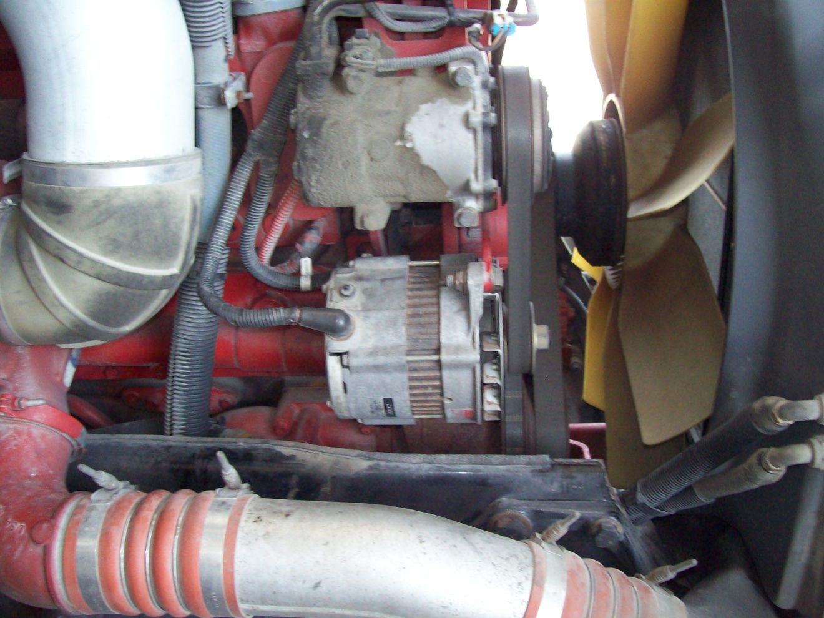
Step # 4
Engine Compartment
Alternator / Type Drive
  Tight and secure
  Wiring connections tight, no damaged insulation
  Fan belts tight and not damaged

Slide 7
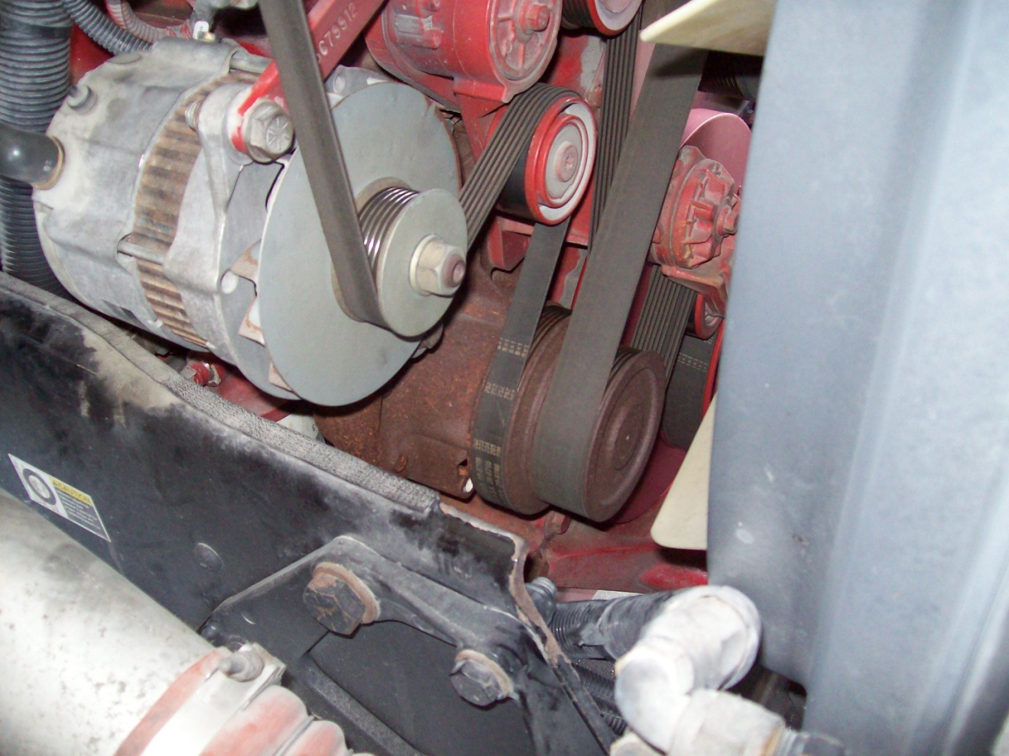
Step # 4
Engine Compartment
Water Pump
  Tight and secure
  Not leaking

Slide 8
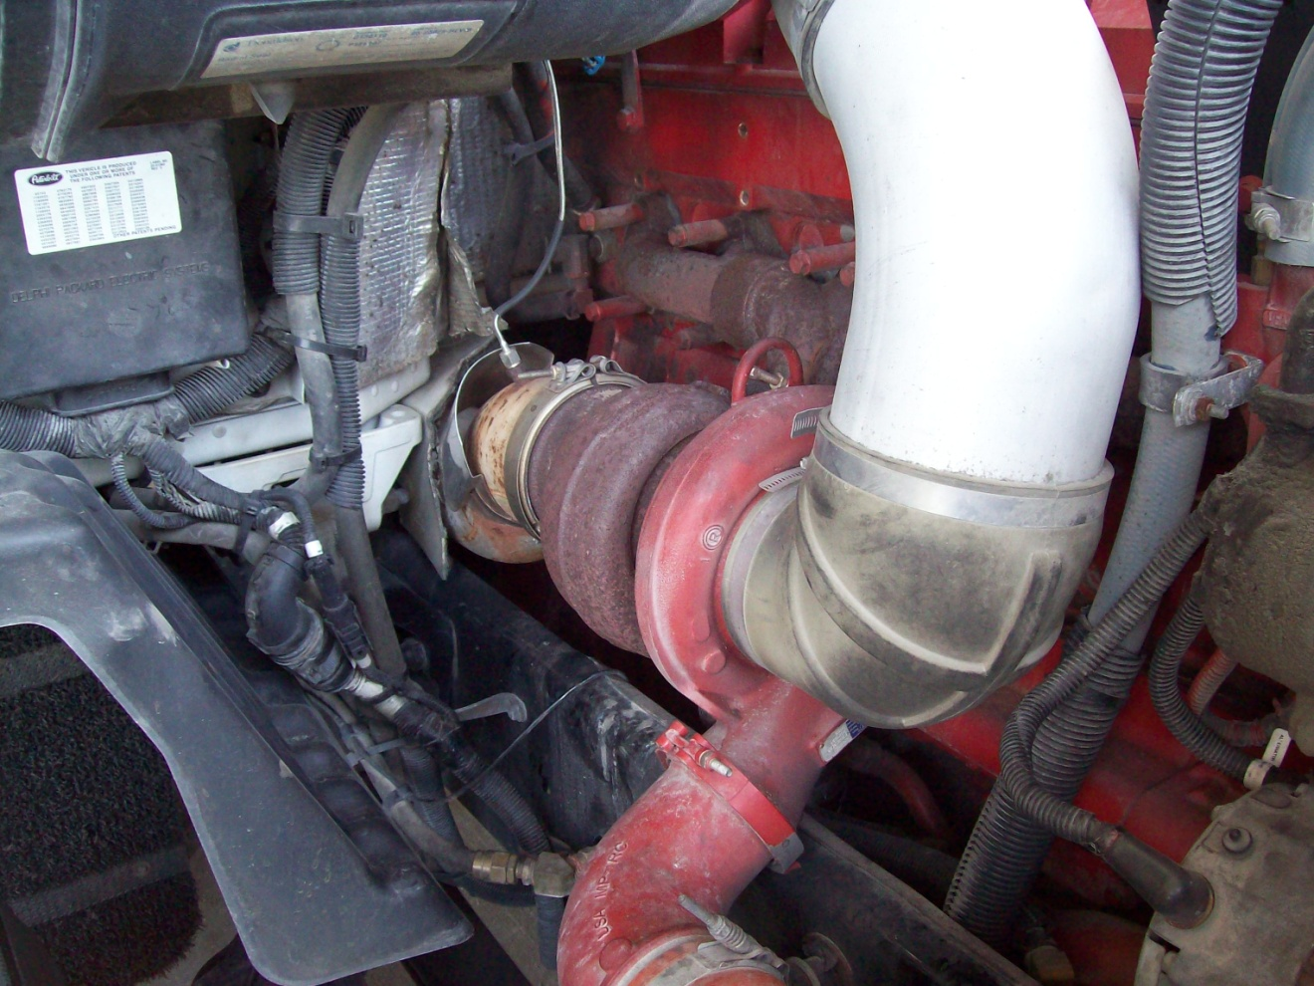
Step # 4
Engine Compartment
Exhaust system tight not leaking
Wiring secured not damaged
All hose clamps tight
No leaks on right side of engine compartment

Slide 9
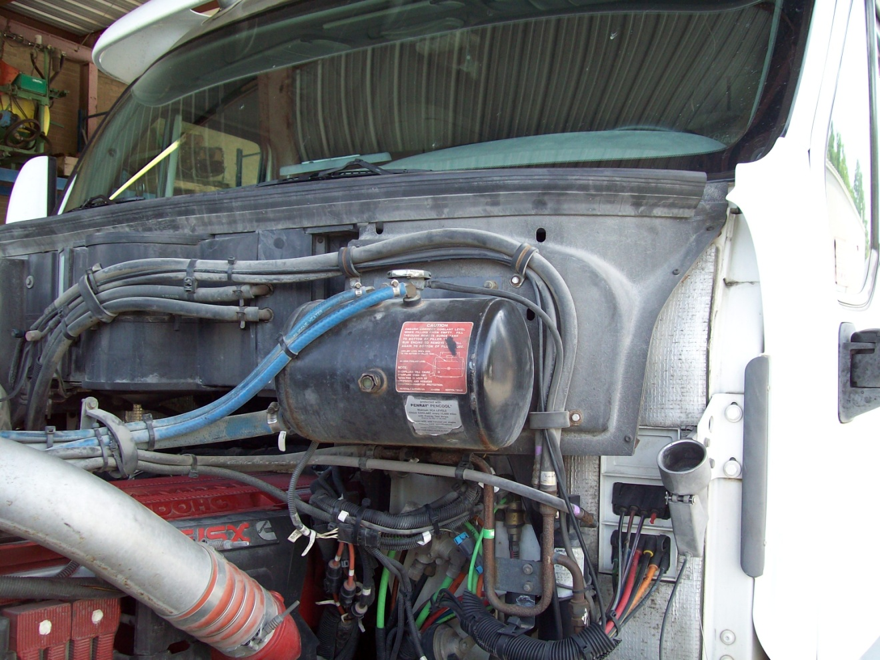
Step # 4
Engine compartment
Coolant level
  Coolant in sight glass
  Reservoir tank tight and secure
  All water hoses secure, clamps tight, no leaks

Slide 10
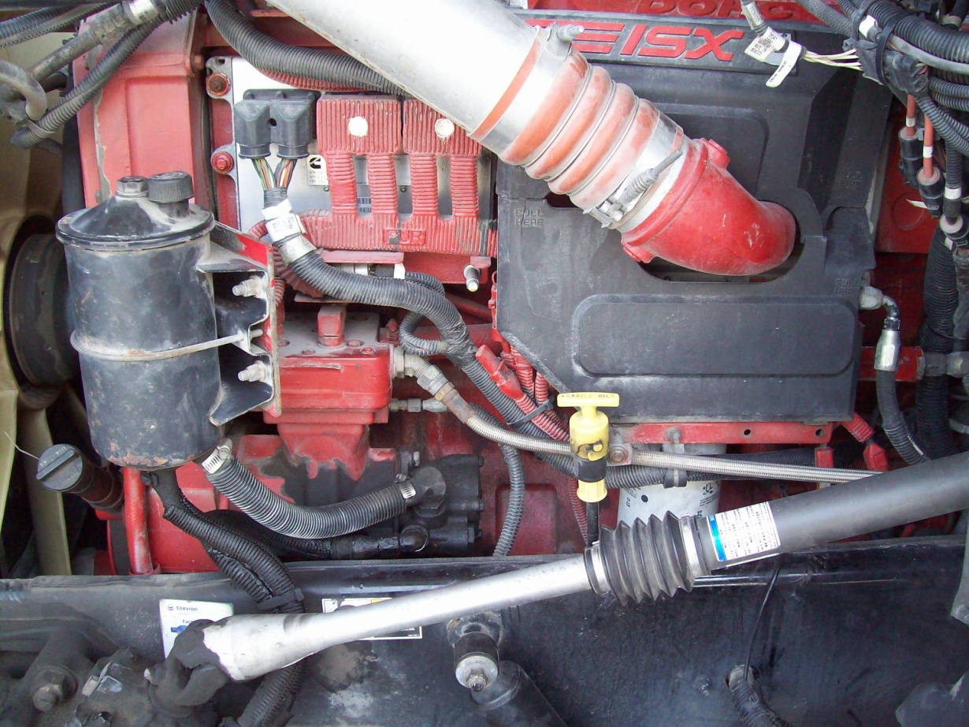
Step # 4
Engine Compartment
Engine oil
  Checked oil level ( O. K. )
  No sign of contamination (gray oil)
Air compressor
  Tight and secured
  Hoses tight no sign of leaks
Power Steering
  Checked oil level ( O. K. )
  Reservoir tight and secure
  Hoses tight no sign of leaks
All other clamps and hoses are tight no sign of leaks. Wiring is secured and not damaged. Left side of engine compartment O.K.
Note : Small leak on top fitting of power steering pump.

Slide 11
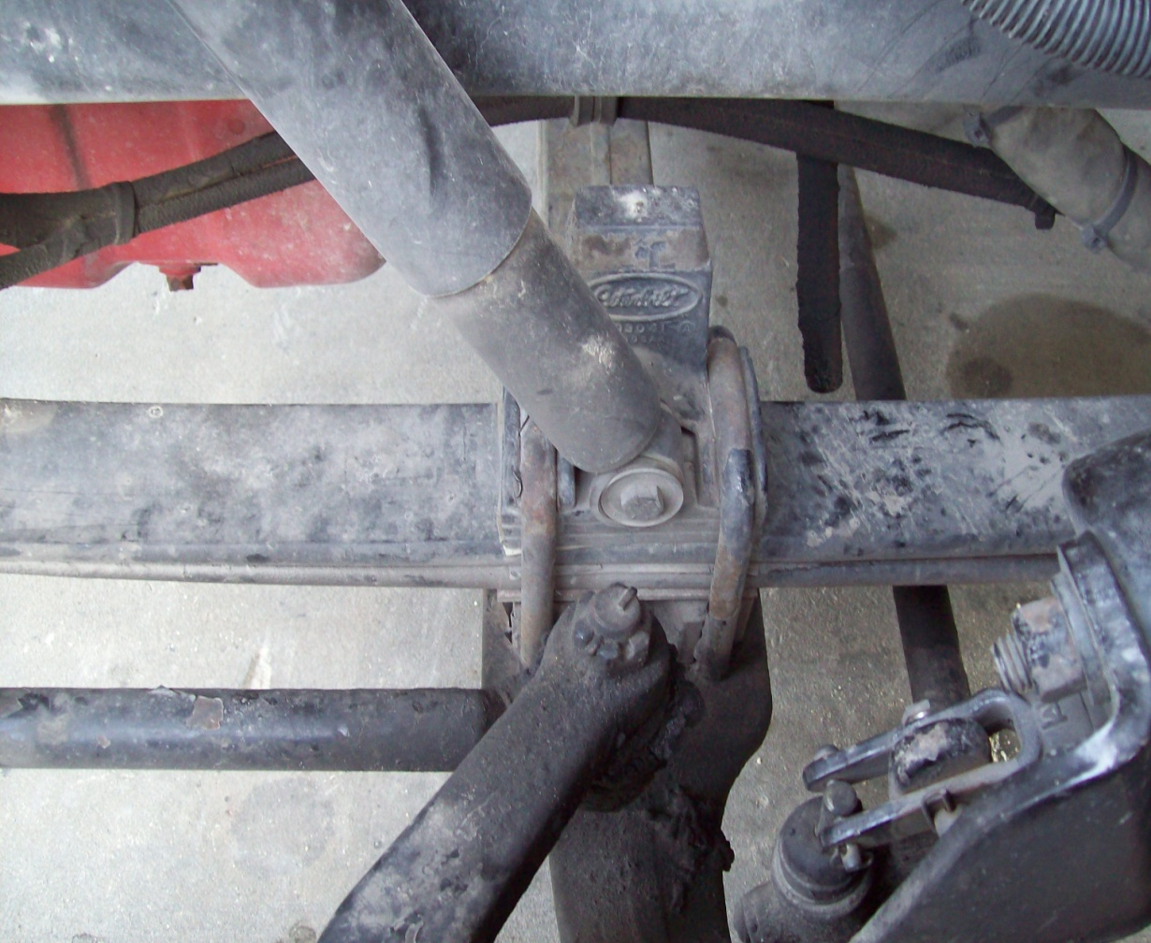
Step # 5
Front Suspension
Shock Absorber
  Bolts tight
  Not Leaking
Leaf Springs
  Not cracked or broken
  U - Bolts tight no sign of slipping

Slide 12
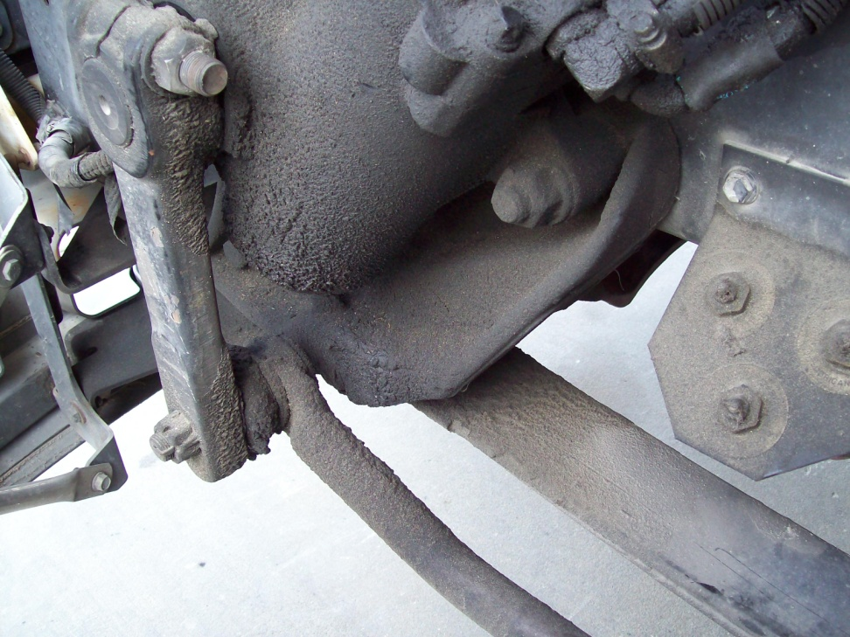
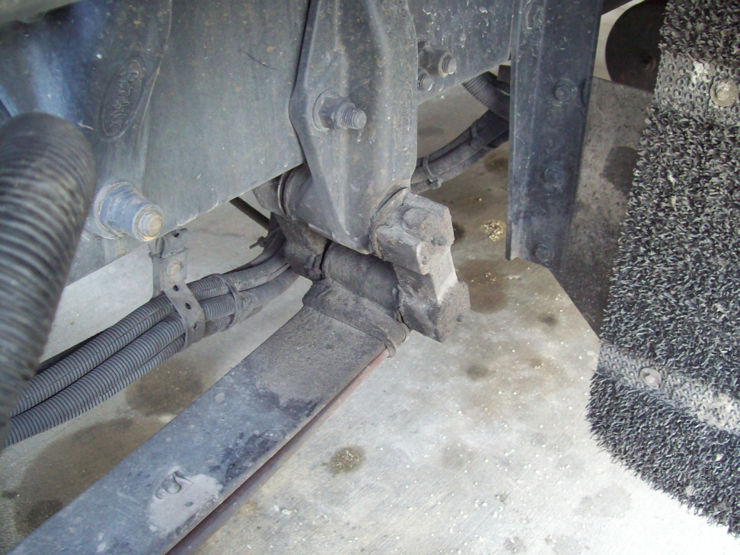
Step # 5
Front Suspension
Front Spring Mount
  Tight and secure
  No sign of wear
Rear Spring Mount
  Tight and secure
  No sign of wear ( Notice angle of rear hanger )

Slide 13
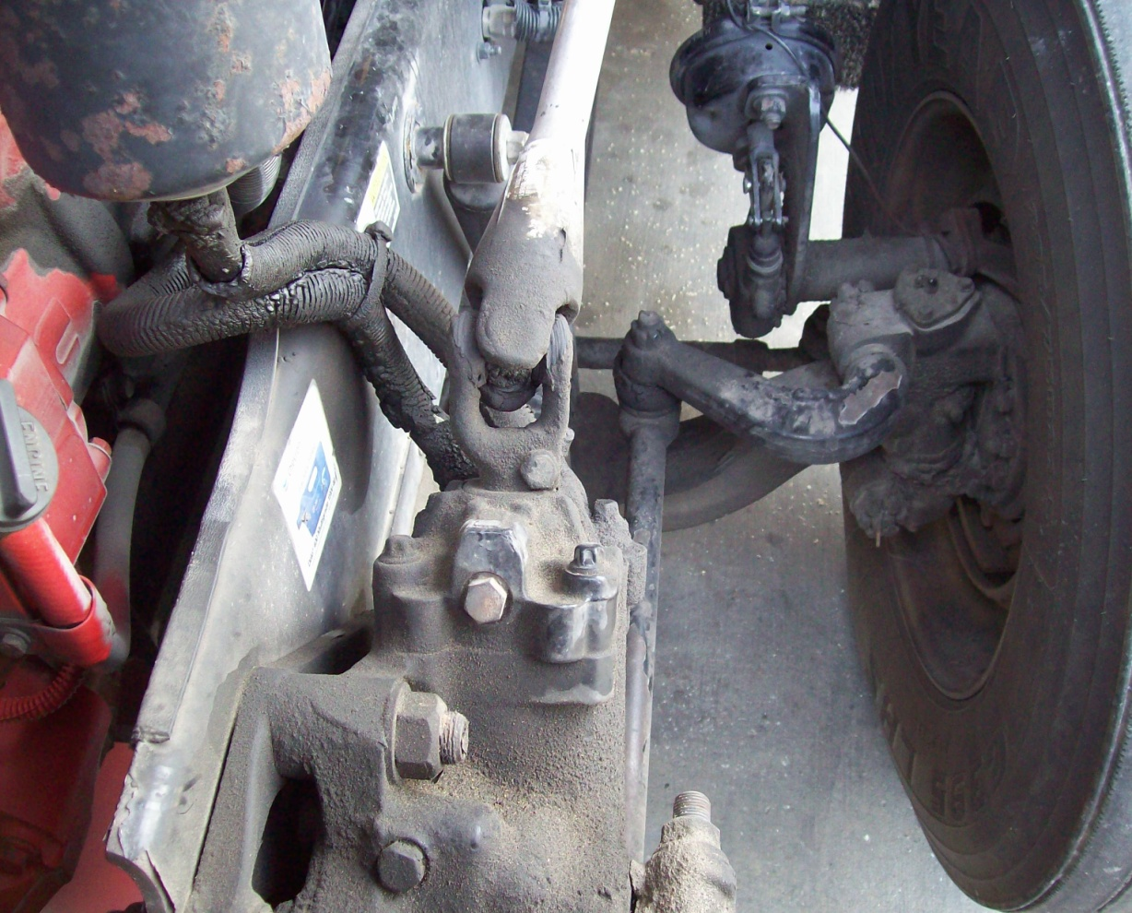
Step # 6
Steering
Steering Linkage (Includes Steering Arm, Drag Link, and Tie Rod).
  All linkage tight
  No excessive wear
  No missing hardware
Steering Box / Hoses
  All bolts tight
  No visible leaks

Slide 14
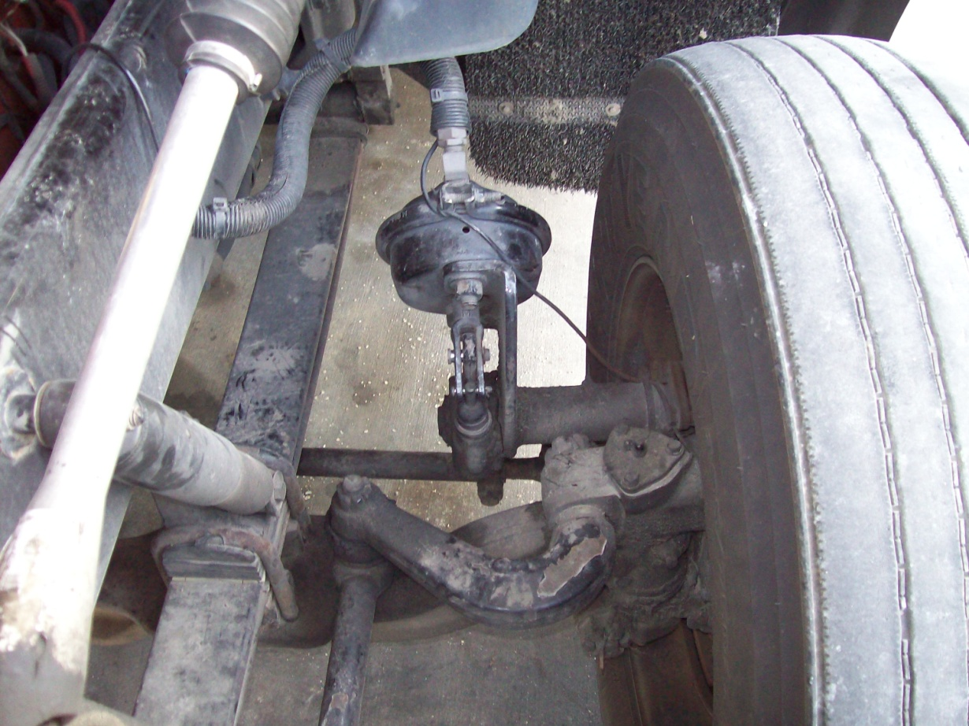
Step # 7
Front Brakes
Lines & Hoses
  Tight secure not rubbing against anything
  No sign of leaks
Chamber
  No loose or missing hardware
  No sign of leaks
Slack Adjuster / Push Rod
  Hardware is secure
  Push Rod not bent
  1 “ Play
Drum / Shoes
  No oil in drum
  No excessive wear
  No cracks, Not discolored

Slide 15
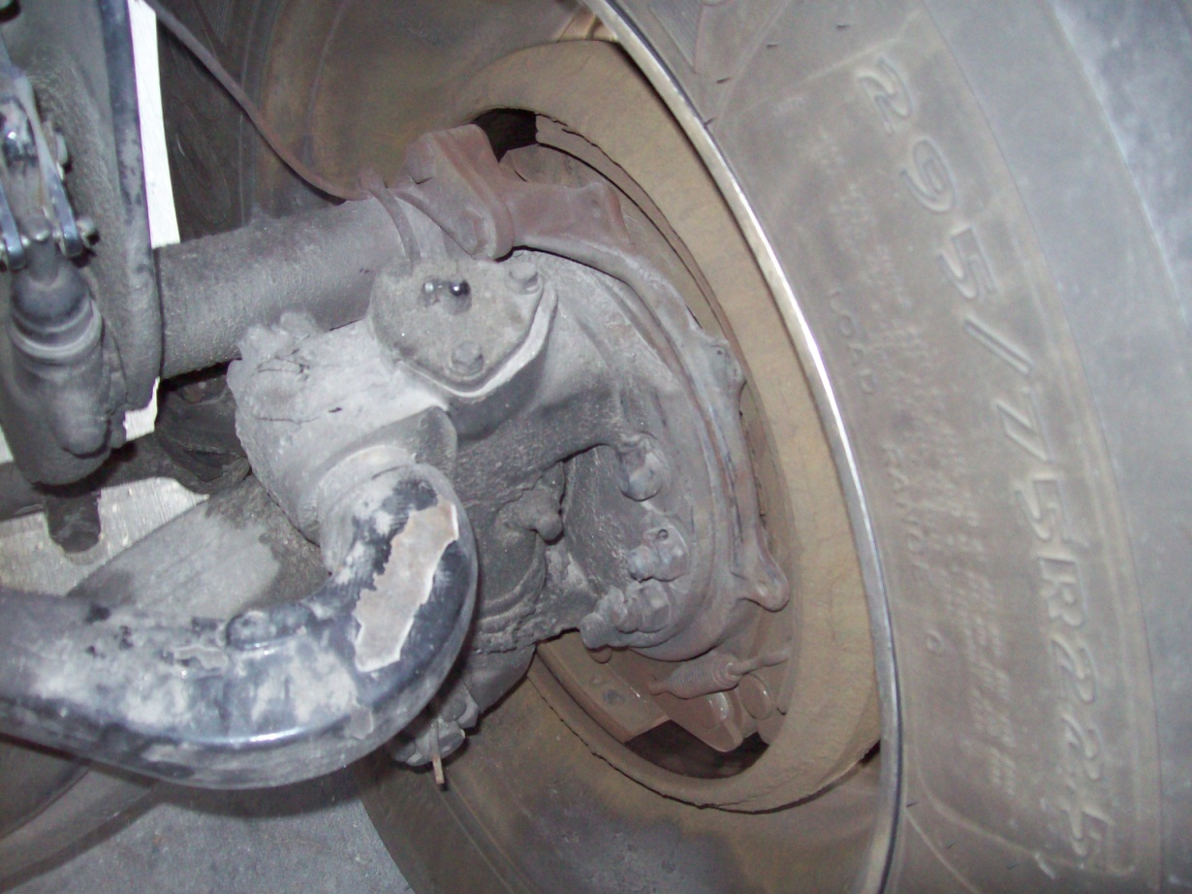
Step # 8
Rim & Tire (T.O.P.)
Inside Rim
  No cracks
  Not bent
  No welds
  Tire & rim properly sealed
Inside Tire
  No cuts
  No cracks
  No bulges

Slide 16
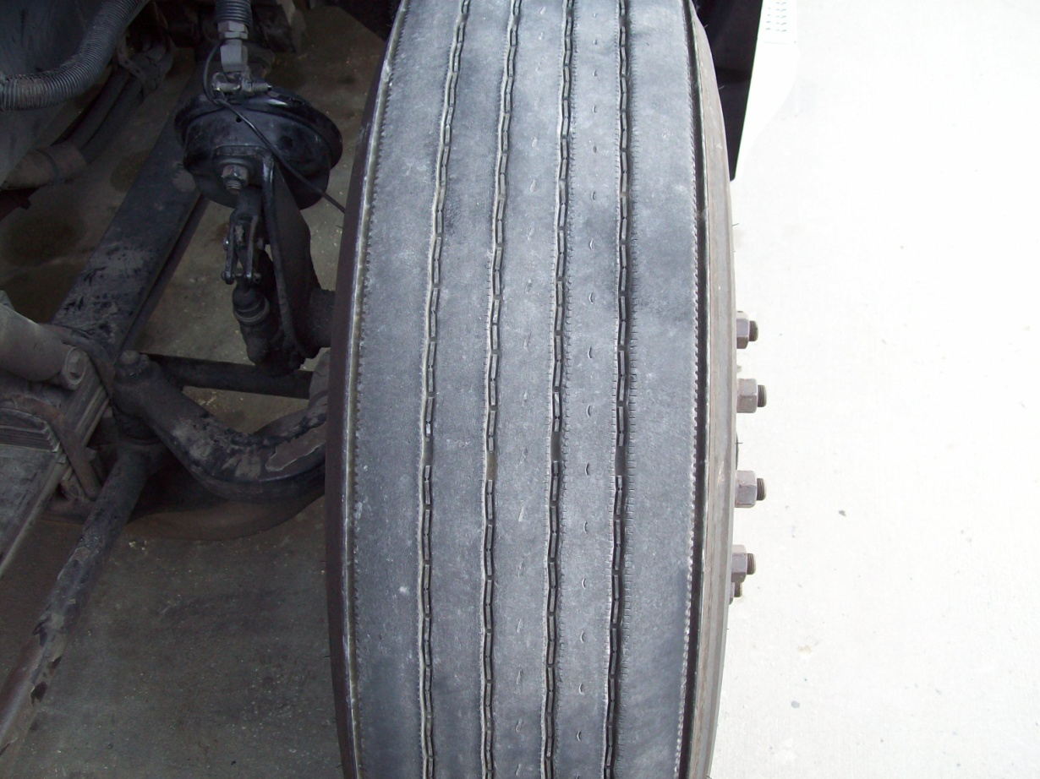
Step # 8
Rim & Tire
Tire Face
  Even wear
  Minimum 4/32” available thread
  Checked with air gauge 110 P.S.I.

Slide 17
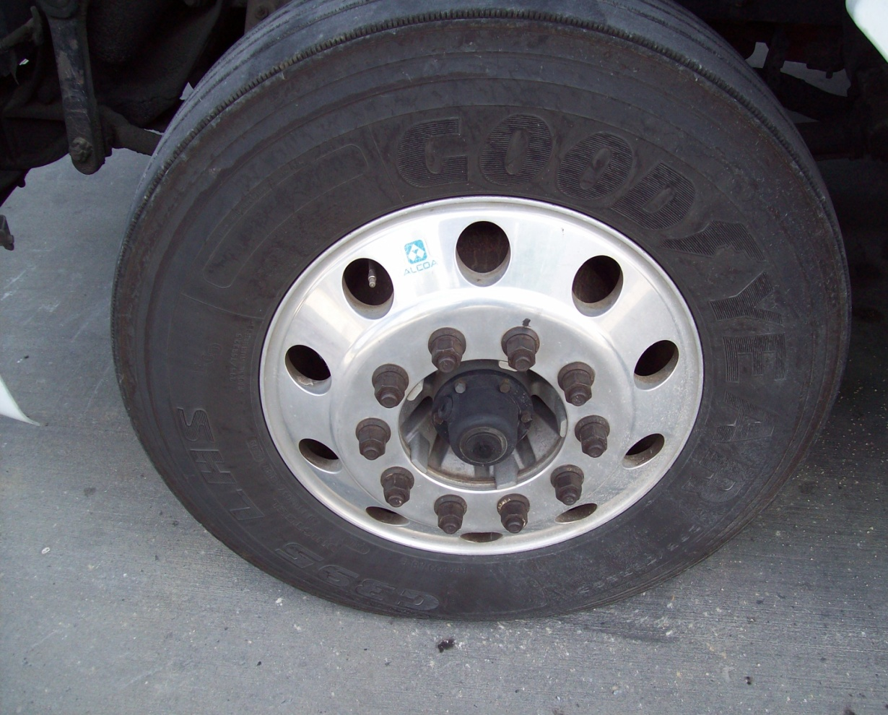
Step # 8
Rim & Tire
Outside of Tire
  No cuts
  No cracks
  No bulges
  Valve stem secure and caped
Rim
  No cracks
  Not bent
  No welds
  Tire & rim properly sealed
Lug Nuts
  Tight (No rust or rusty streaks that would signal loose nuts)
Hub Cap
  Not cracked
  Not leaking
  Oil level O.K.
Note : At this time you my close the hood. Make certain it latches good on both sides.

Slide 18
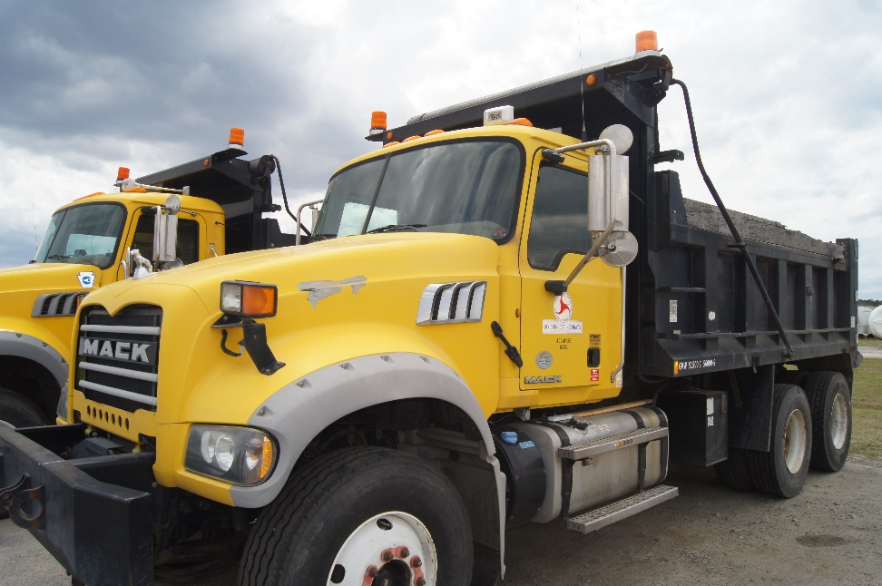
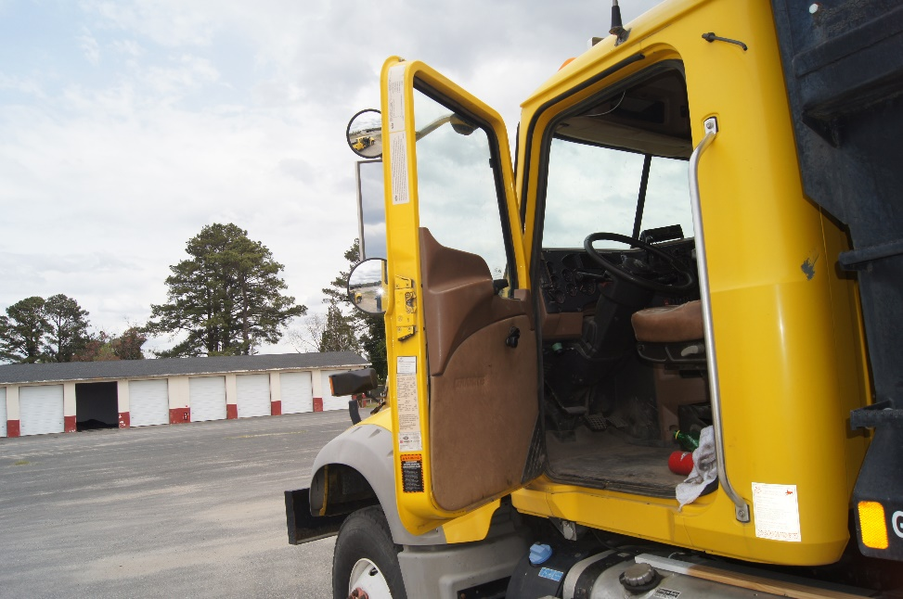
Step # 9
Cab (Side)
Mirror
  Mirror secure
  Glass not cracked or broken
Driver Door
  (Open Door) check hinges and latch for wear
  Check operation of window and condition of glass

Slide 19
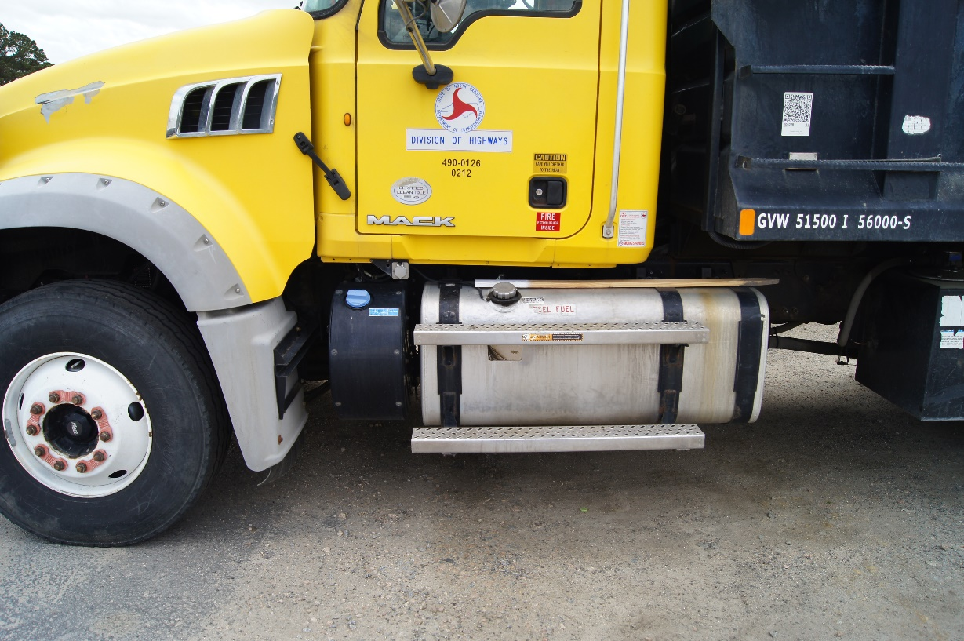
Step # 9
Cab (Side)
Hand Rail
  Tight and secure
Turn – Signal Light
  Secure, lens not cracked or broken
Steps
  In place
  Tight and secure
  No missing hardware
Fuel Tank
  Tight and secure (look at straps)
  Cap in place and tight
  No leaks

Slide 20
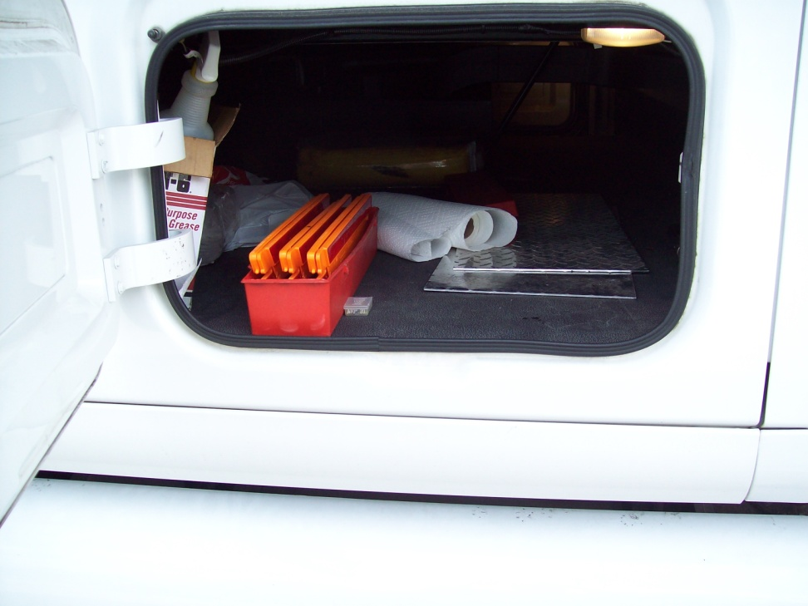
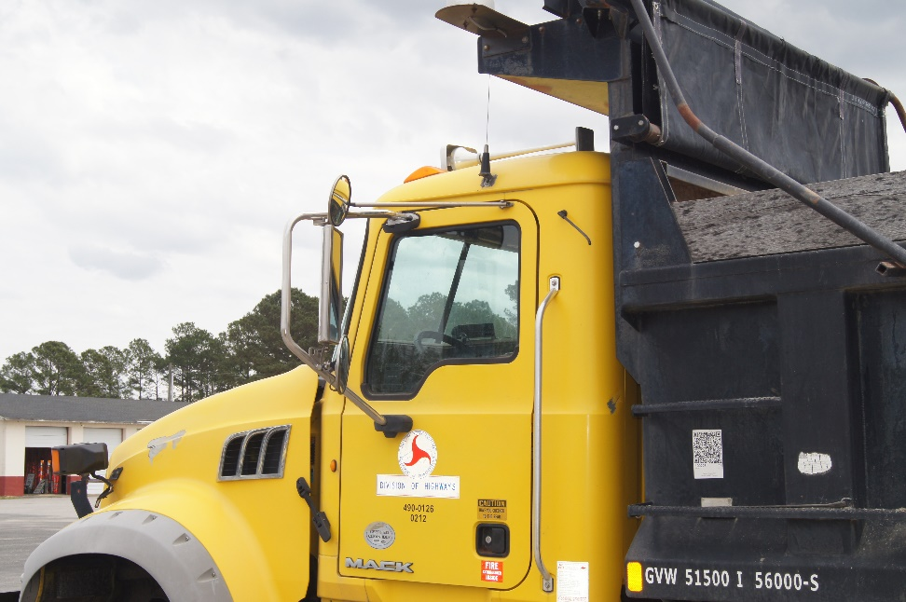
Step # 9
Truck (Side)
Side of Truck
  Nothing loose , everything in place
  Glass not cracked or broken
Safety / Emergency Equip. (F.E.T.)
  Check for three emergency triangles, fuses, and fire extinguisher.

Slide 21
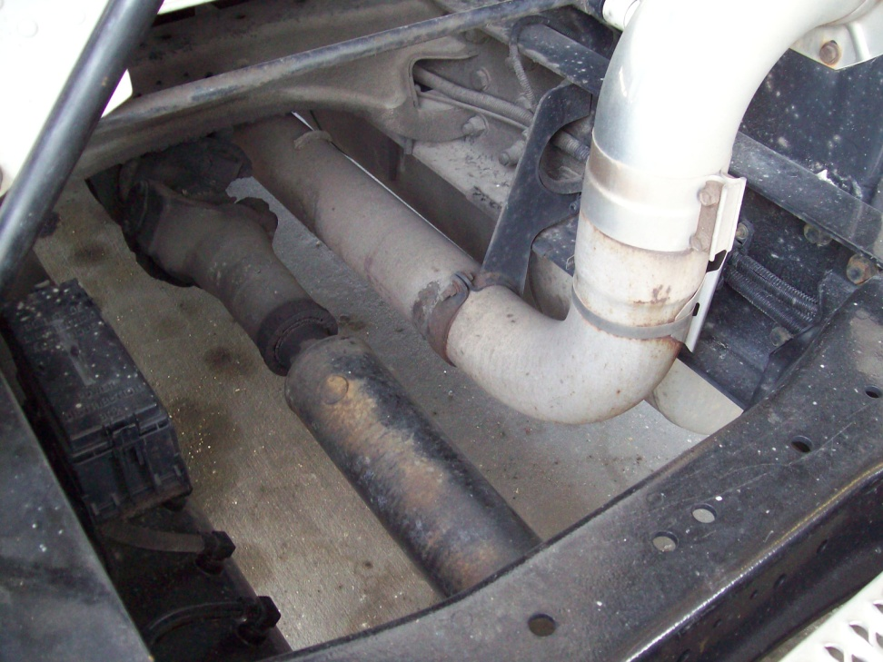
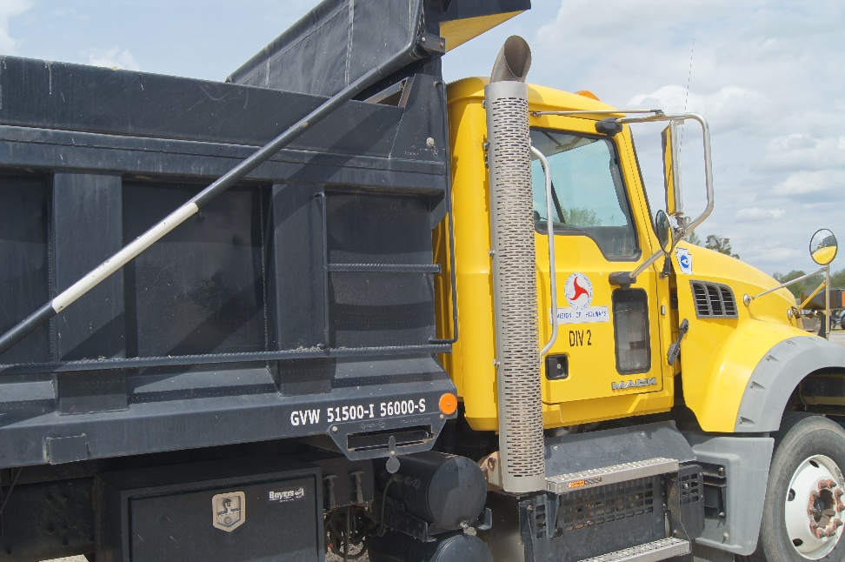
Step # 10
Truck (Under carriage)
Exhaust System
  All pipes, clamps, braces, shields tight and secure
  No leaks (look for soot on exhaust system)
Drive Shaft
  Not bent, no dents, U – joints tight
  look for leaking at both ends

Slide 22
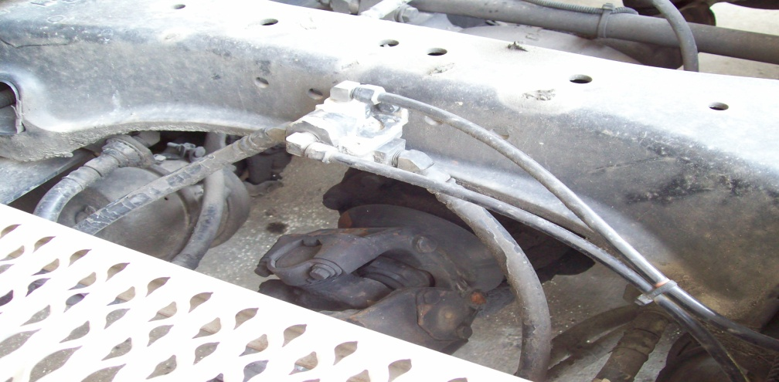
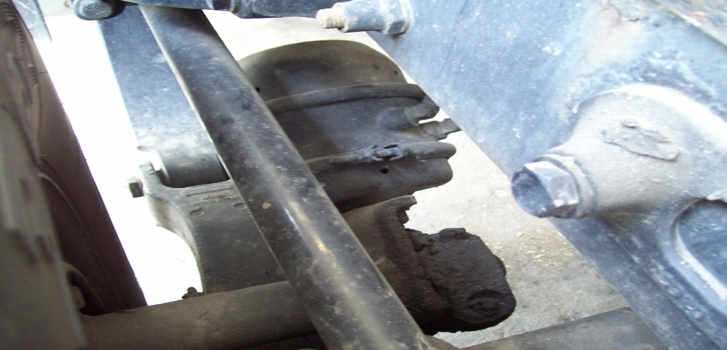
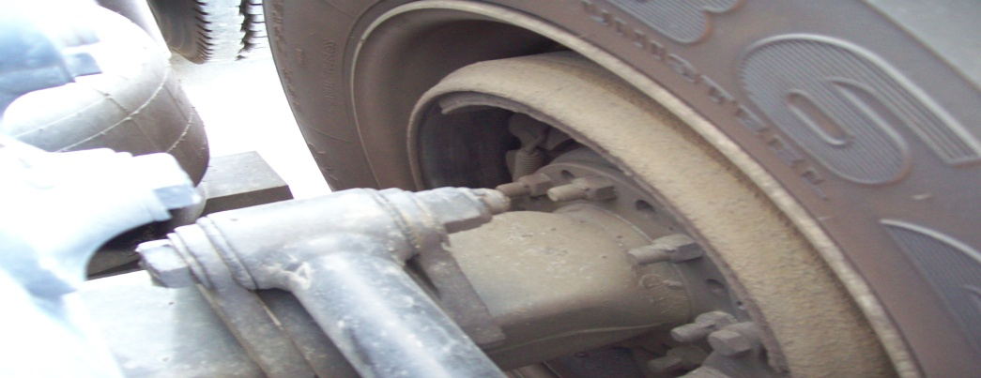
Step # 11
Rear Brakes
Lines & Hoses
  Tight secure not rubbing against anything
  No sign of leaks
Chamber
  No loose or missing hardware
  No sign of leaks
Slack Adjuster / Push Rod
  Hardware is secure
  Push rod not bent
  1 “ play
Drum / Shoes
  No oil in drum
  No excessive wear
  No cracks, not discolored

Slide 23
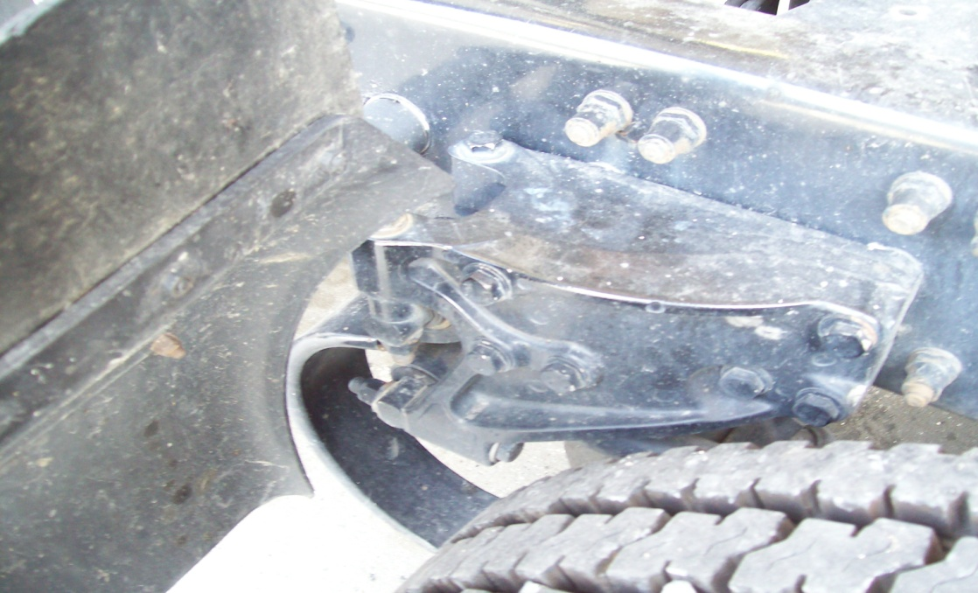
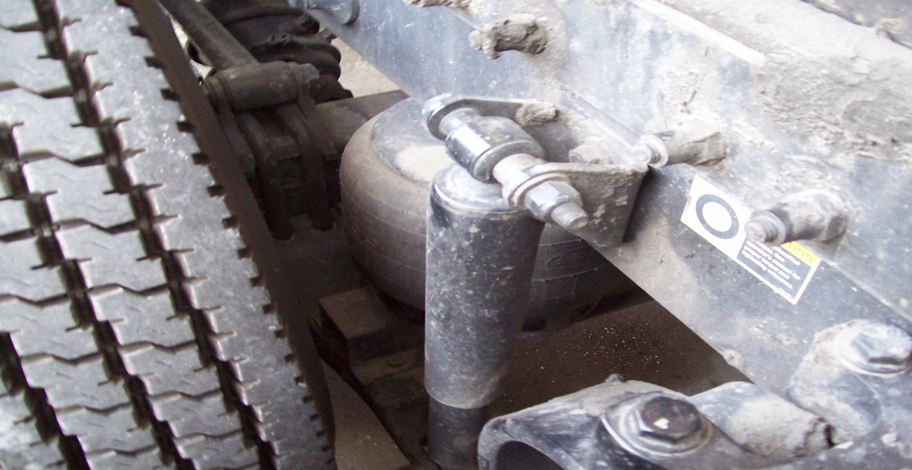
Step # 12
Rear Suspension
Front Mount
  All hardware tight and secure
  No excessive wear
Torsion Bar Spring
  Secure in mount not broken
  U – bolts tight no sign of being loose
  Torque rod secure and tight
  Rear of spring not broken
Air Spring ( Air Bag )
  All hardware tight and secure
  Pumped up no sign of leaks
  Nothing rubbing it
Shock Absorber
  Bolts tight
  No sign of leaks

Slide 24
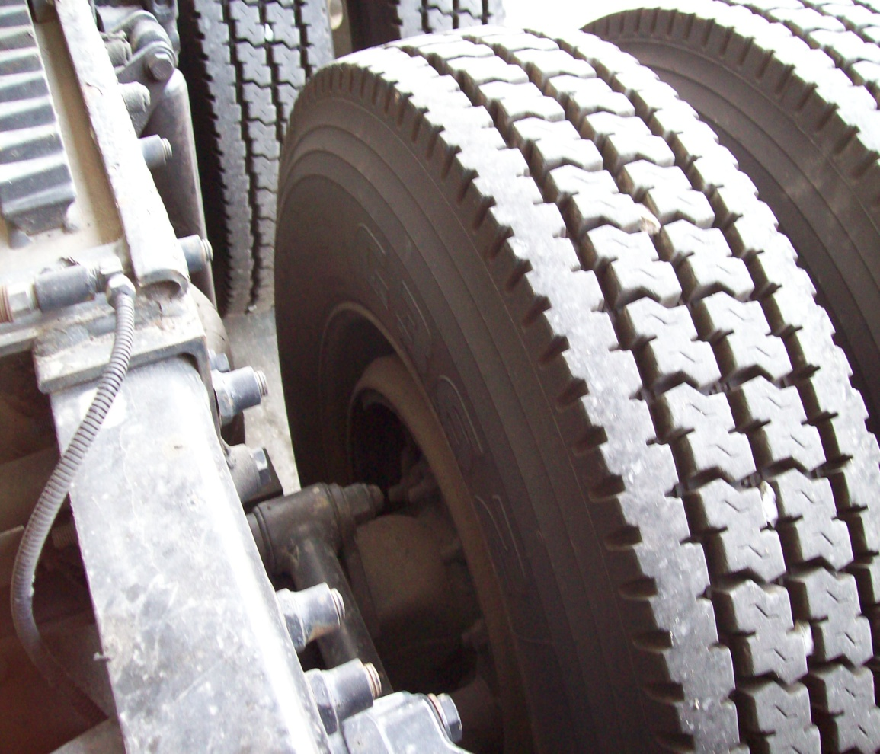
Step #13
Rims & Tires (T.O.P.)
Inside Rim
  No cracks
  Not bent
  No welds
  Tire & rim properly sealed
Inside Tire
  No cuts
  No cracks
  No bulges

Slide 25
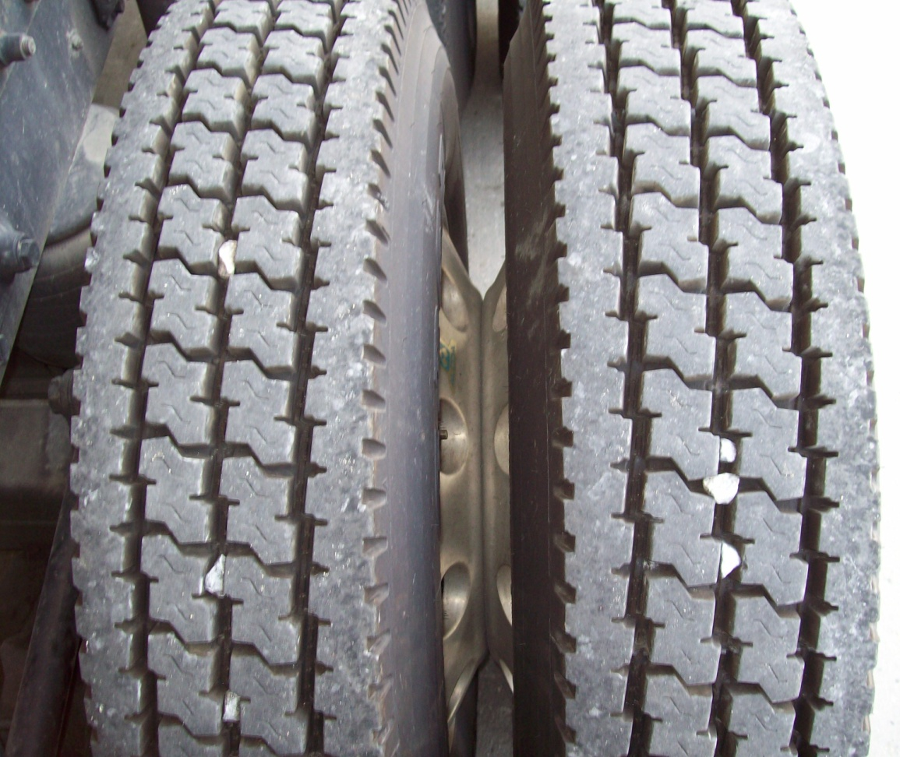
Step # 13
Rims & Tires
Tire Face ( Both Tires )
  Even wear
  Minimum 2/32” available thread
  Checked with air gauge 100 P.S.I.
Inner Rims / Spacing
  No cracks
  Not bent
  No welds
  Tires & Rims properly sealed
  Budd spacing

Slide 26
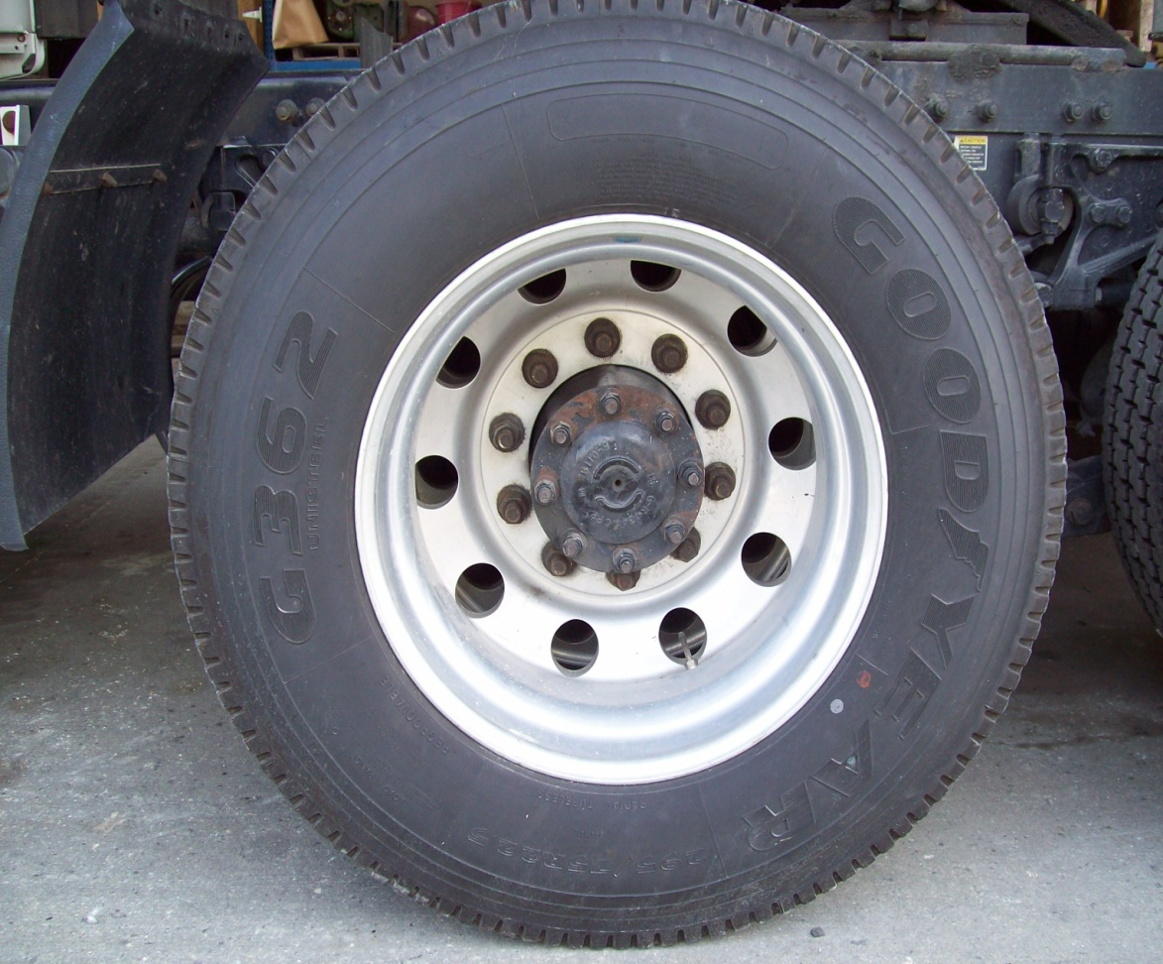
Step # 13
Rims & Tires
Outside of Tire
  No cuts
  No cracks
  No bulges
  Valve stems secure and caped
Rim
  No cracks
  Not bent
  No welds
  Tire & rim properly sealed
Lug Nuts
  Tight ( No rust or rusty streaks that would signal loose nuts )
Drive Axle to Hub
  Nuts or bolts tight and secure
  Not leaking

Slide 27
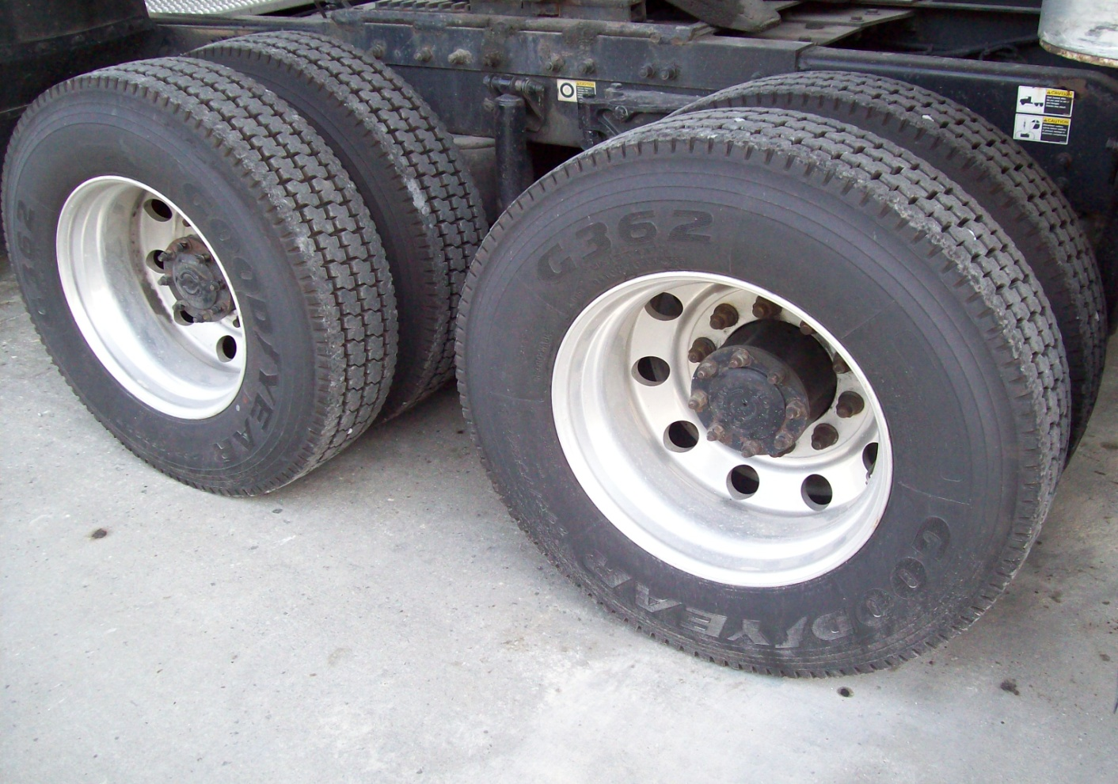
Step # 14
Check Rear Axle Same Way As Front
Note: This is now optional

Slide 28
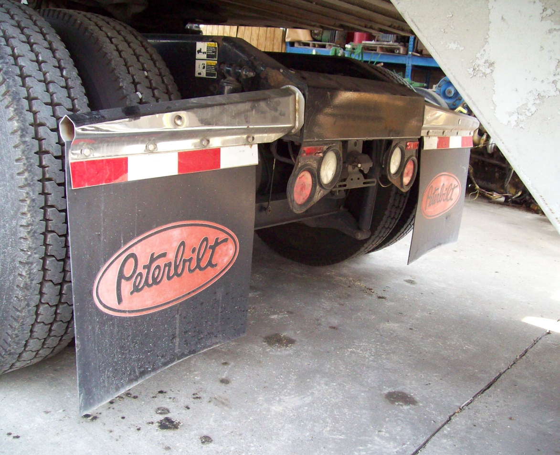
Step # 15
Rear of Truck
Rear Lights
  All lights in place
  No cracked or missing lens
Splash Guards
  Hangers tight and secure
  Splash guards in good condition
  Guards should be hanging less than 6” from ground
Tailgate
  Tight and secure
Air / Electrical Service Lines
  Air lines tight and secure
  No sign of leaks
  Electrical line locked in connector and secure
  No damage to insulation
Note: Any optional equipment such as lights, reflectors, etc. mounted on the truck or trailer must be in good working condition.

Slide 29
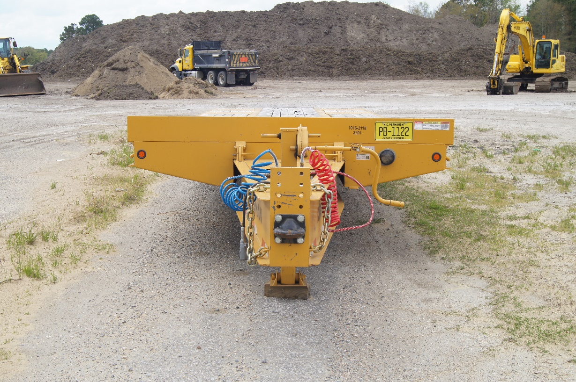
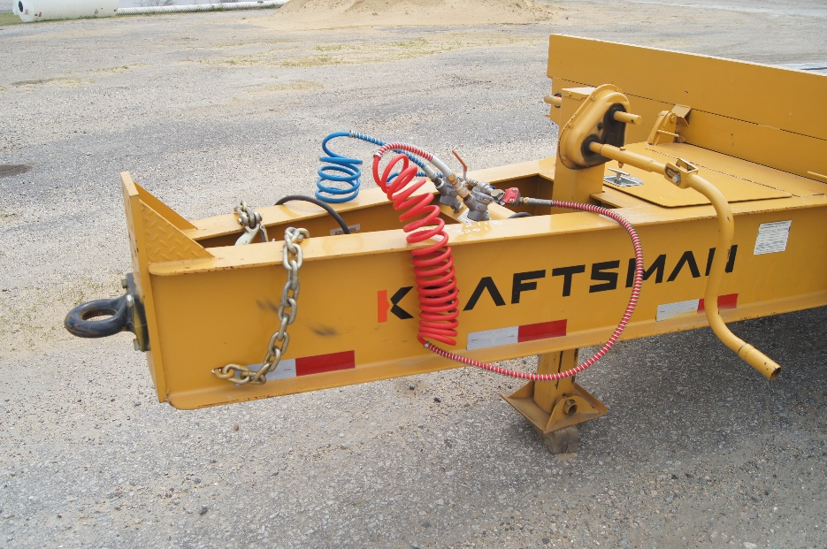
Step # 16
Front of Trailer
Clearance Lights
  All lights in place
  Lens not cracked or broken
Air / Electrical Service Lines
  Glad hands tight and lines secure
  No sign of leaking
  Electrical line secure in connector
  No sign of damage to insulation
  Pintle hitch

Slide 30
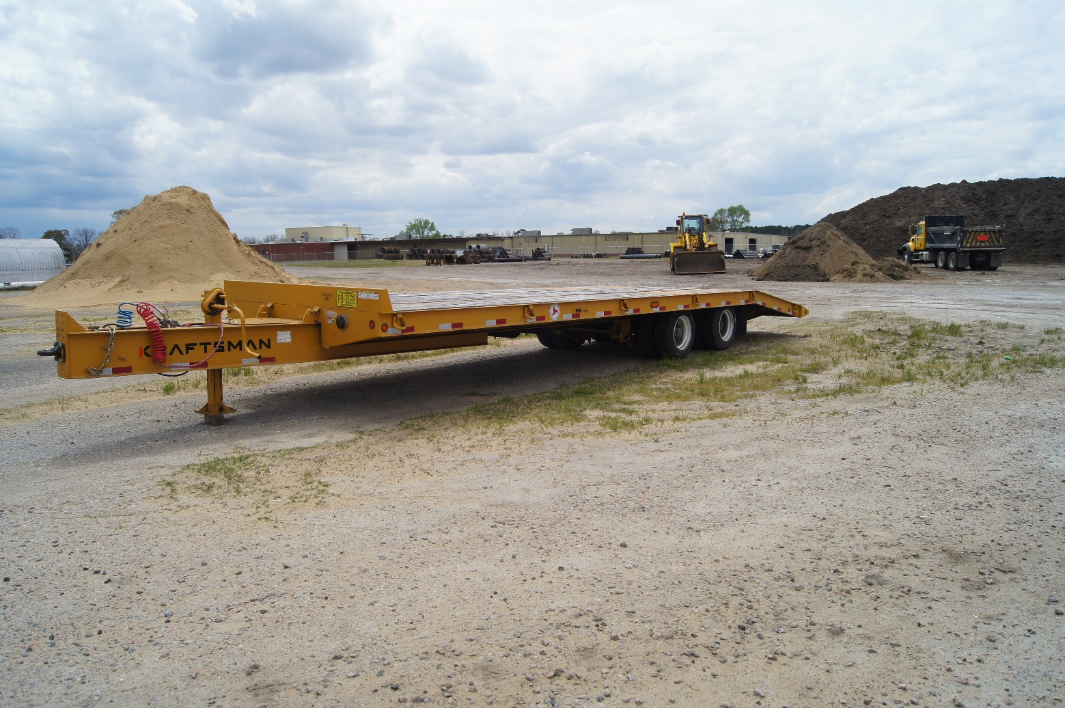
Step # 17
Side of Trailer
Side of Trailer
  No loose boards or missing parts
  Reflectors and bottom lights secure nothing missing

Slide 31
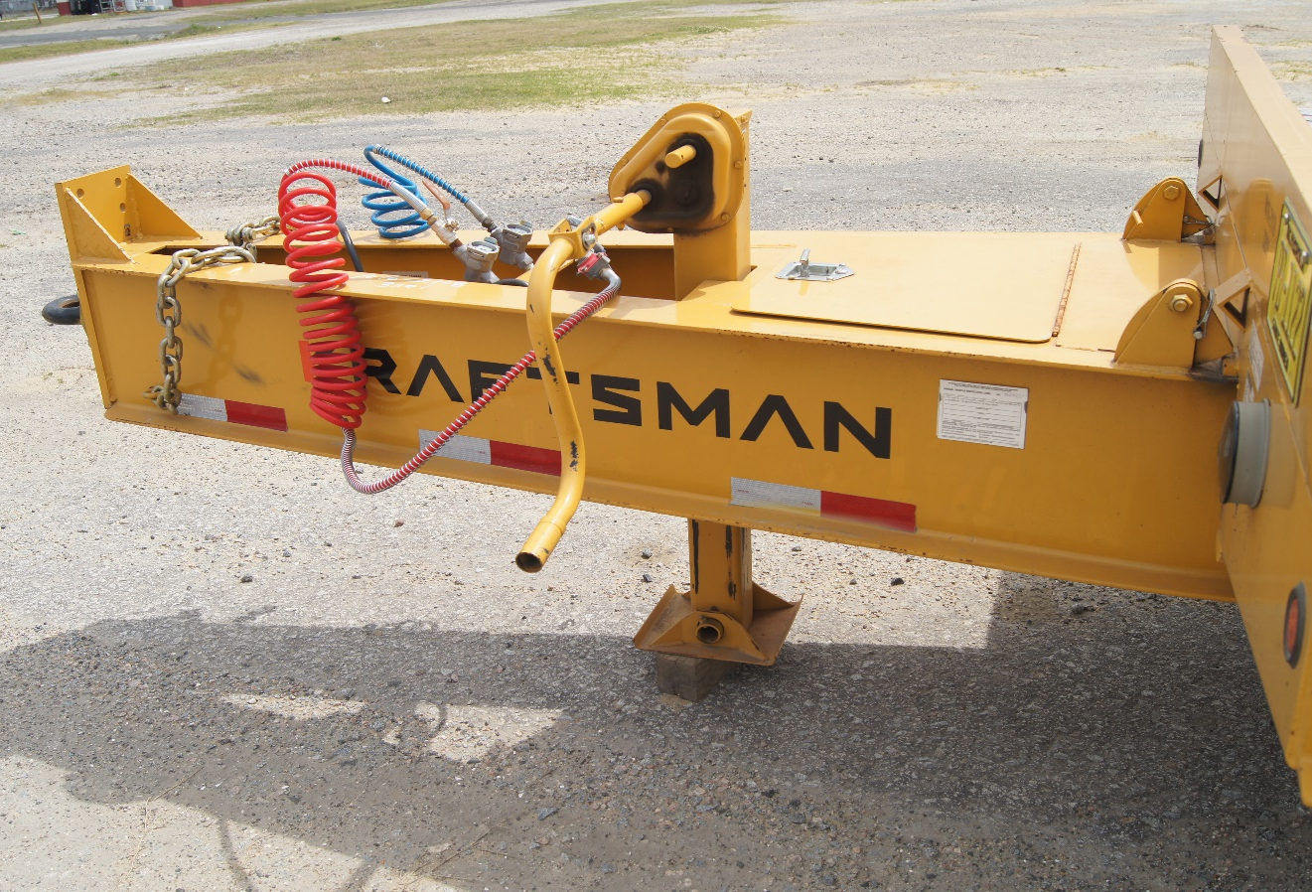
Step # 18
Landing Gear
Landing gear components are tight with no missing hardware. Two speed gear box works and handle is secured.

Slide 32
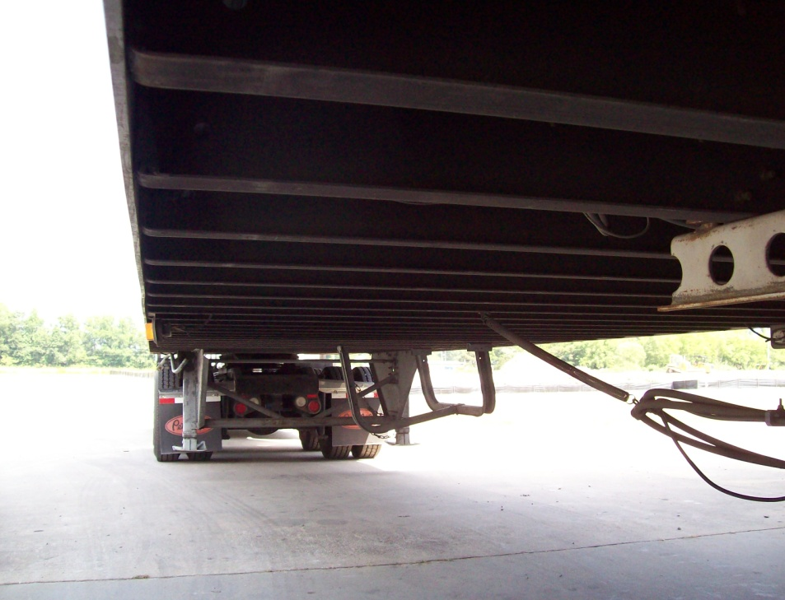
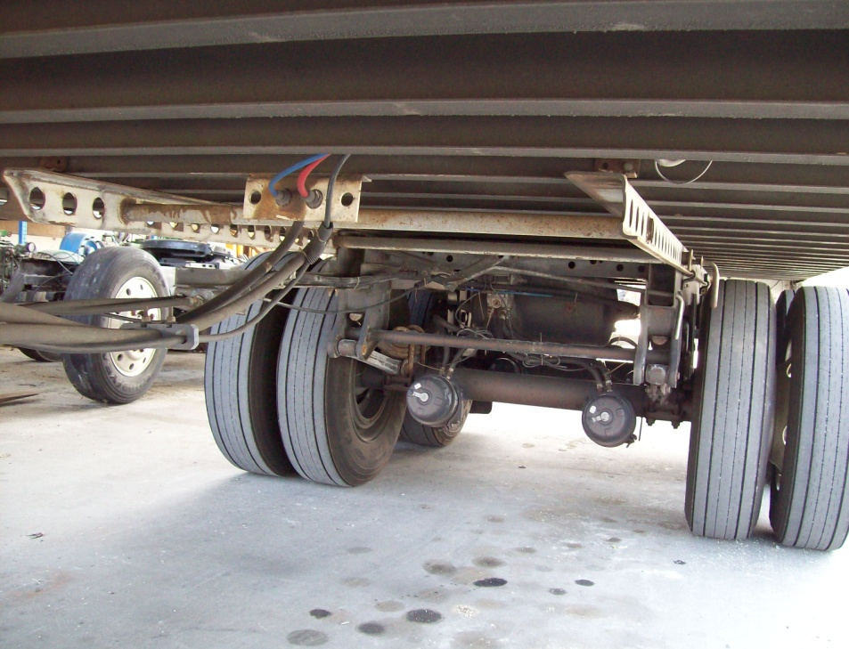
Step # 19
Bottom Frame of Trailer
Frame Forward
  No cracked or missing ribs
  Nothing broken or hanging down
Frame Rear
  No broken or missing ribs nothing hanging down
  Sliding frame not broke, tight and secure

Slide 33
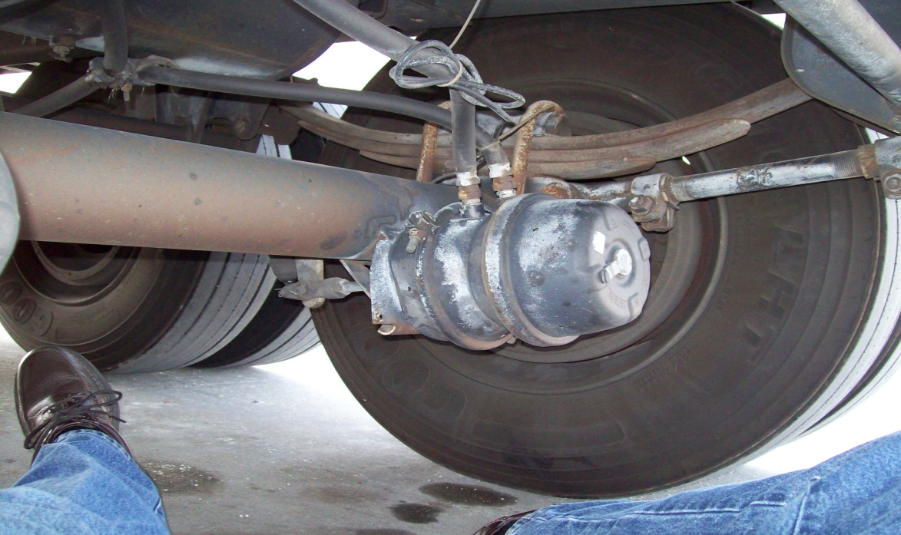
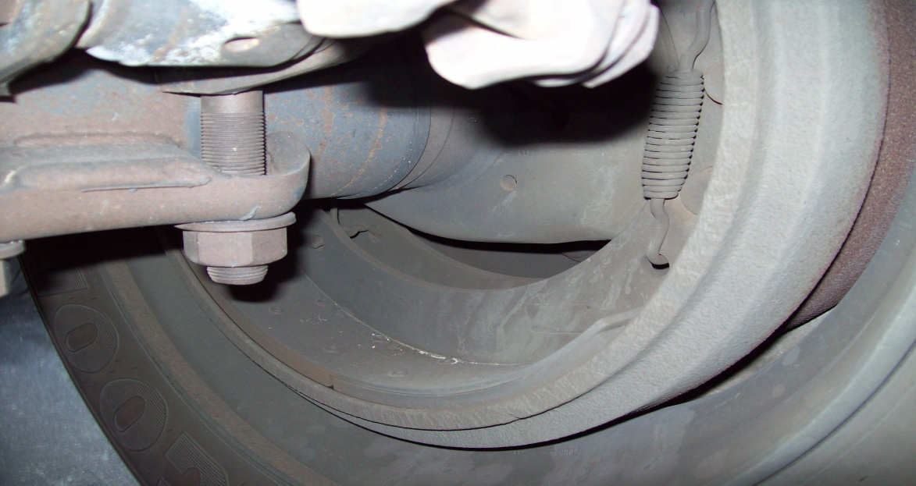
Step # 20
Trailer Brakes
Lines & Hoses
  Tight secure not rubbing against anything
  No sign of leaks
Chamber
  No loose or missing hardware
  No sign of leaks
Slack Adjuster / Push Rod
  Hardware is secure
  Push rod not bent
  1 “ play
Drum / Shoes
  No oil in drum
  No excessive wear
  No cracks, not discolored

Slide 34
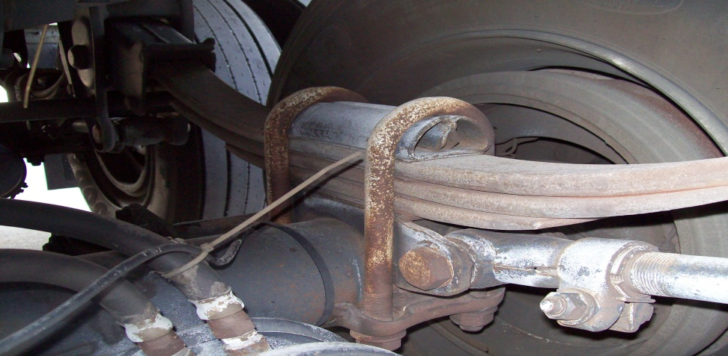
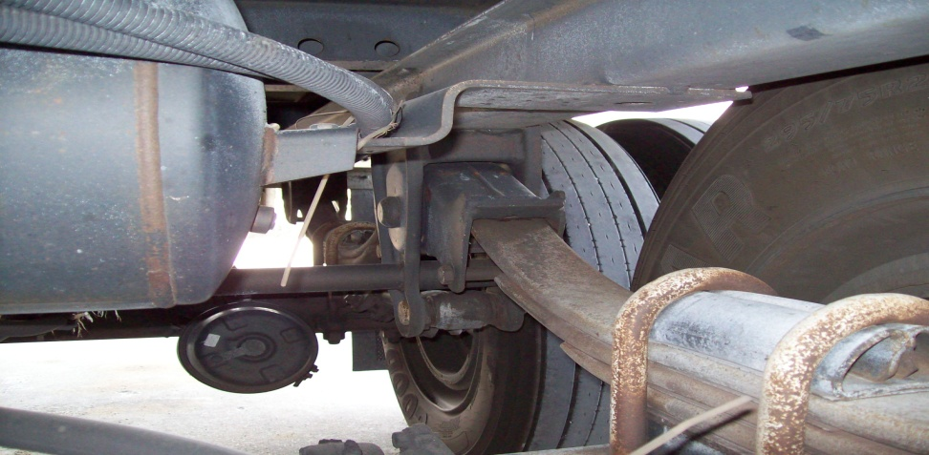
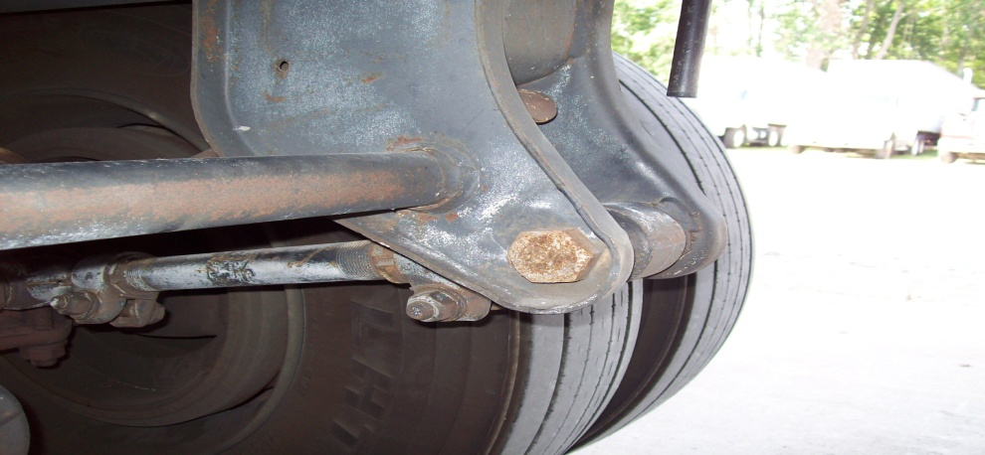
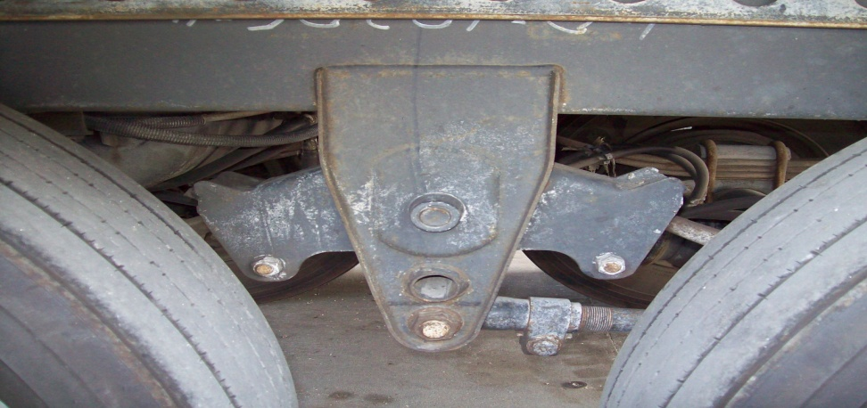
Step # 21
Trailer Suspension
Leaf Springs
  Not cracked or broken
  U – bolts tight no sign of slipping
Front and Rear Spring Mounts
  Mounts and torque rod secured not loose or worn
  Note : Rear mount it is a equalizer

Slide 35
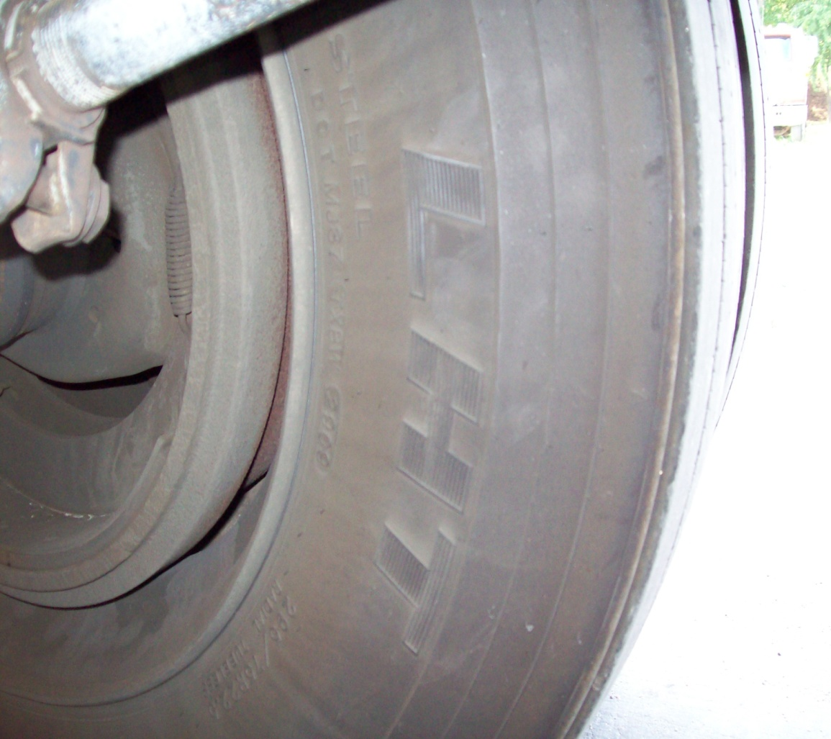
Step # 22
Rims & Tires (T.O.P.)
Inside Rim
  No cracks
  Not bent
  No welds
  Tire & rim properly sealed
Inside Tire
  No cuts
  No cracks
  No bulges

Slide 36
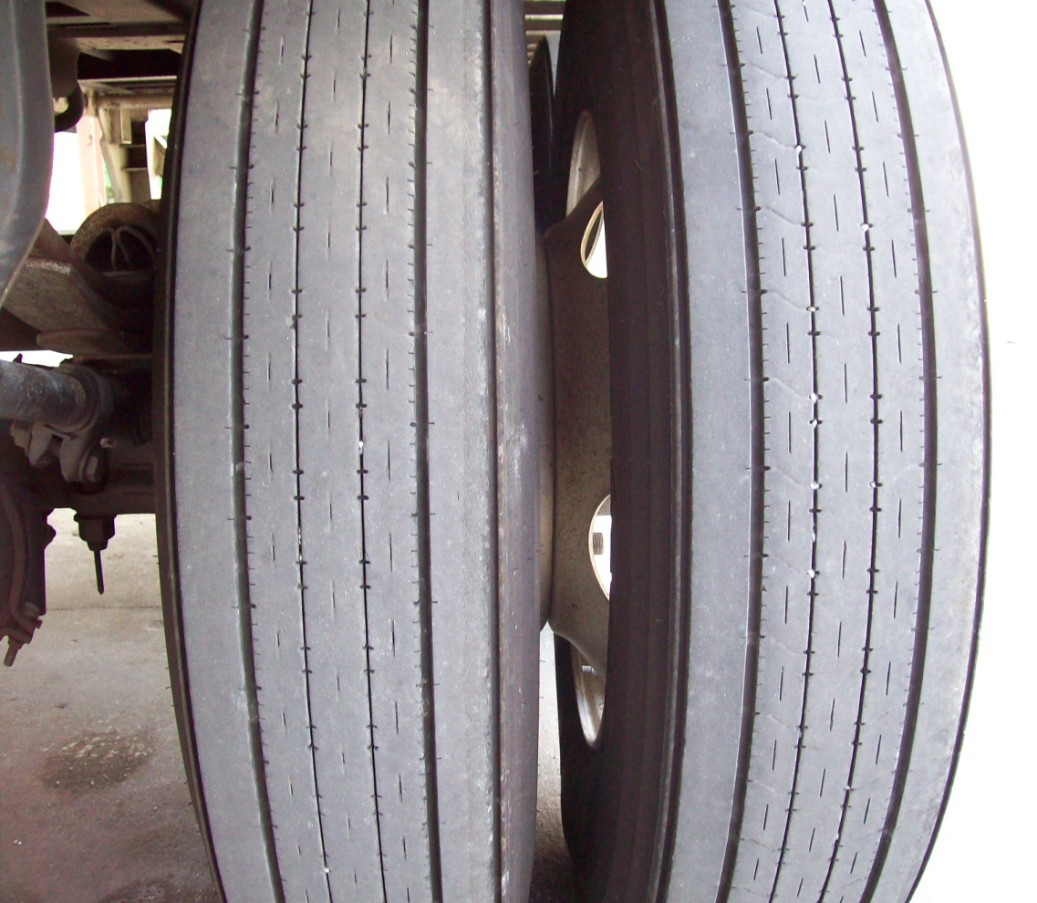
Step # 22
Rims & Tires
Tire Face ( Both Tires )
  Even wear
  Minimum 2/32” available thread
  Checked with air gauge 100 P.S.I.
Inner Rims / Spacing
  No cracks
  Not bent
  No welds
  Tires & rims properly sealed
  Budd spacing

Slide 37
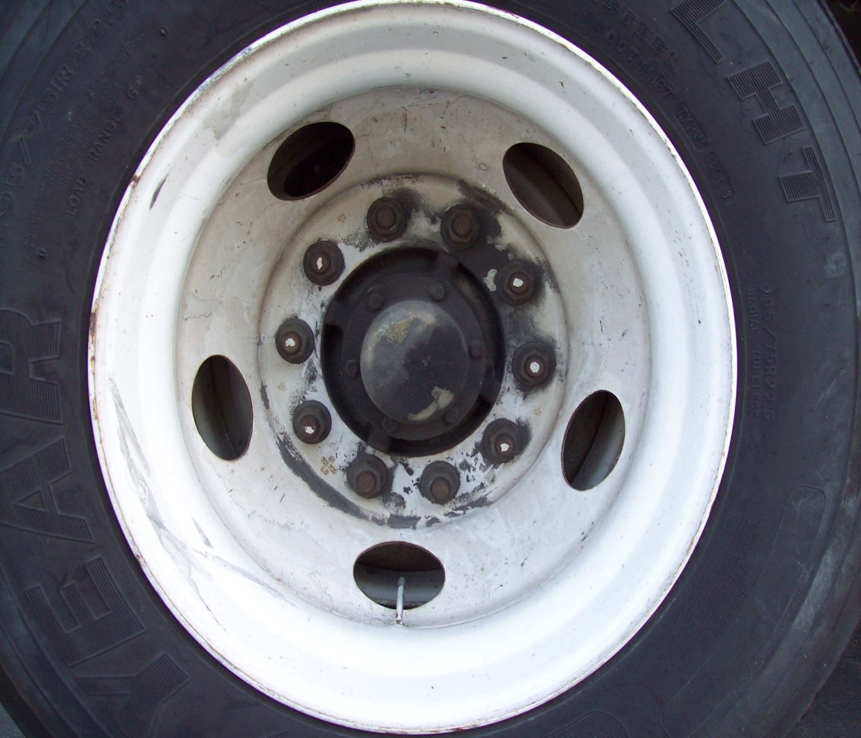
Step # 22
Rims & Tires
Outside of Tire
  No cuts
  No cracks
  No bulges
  Valve stems secure and caped
Rim
  No cracks
  Not bent
  No welds
  Tire & rim properly sealed
Lug Nuts
  Tight (No rust or rusty streaks that would signal loose nuts)
Hub Cap
  Bolts tight
  Not leaking
Note : Trailer hubs can use grease or oil for lubrication!

Slide 38
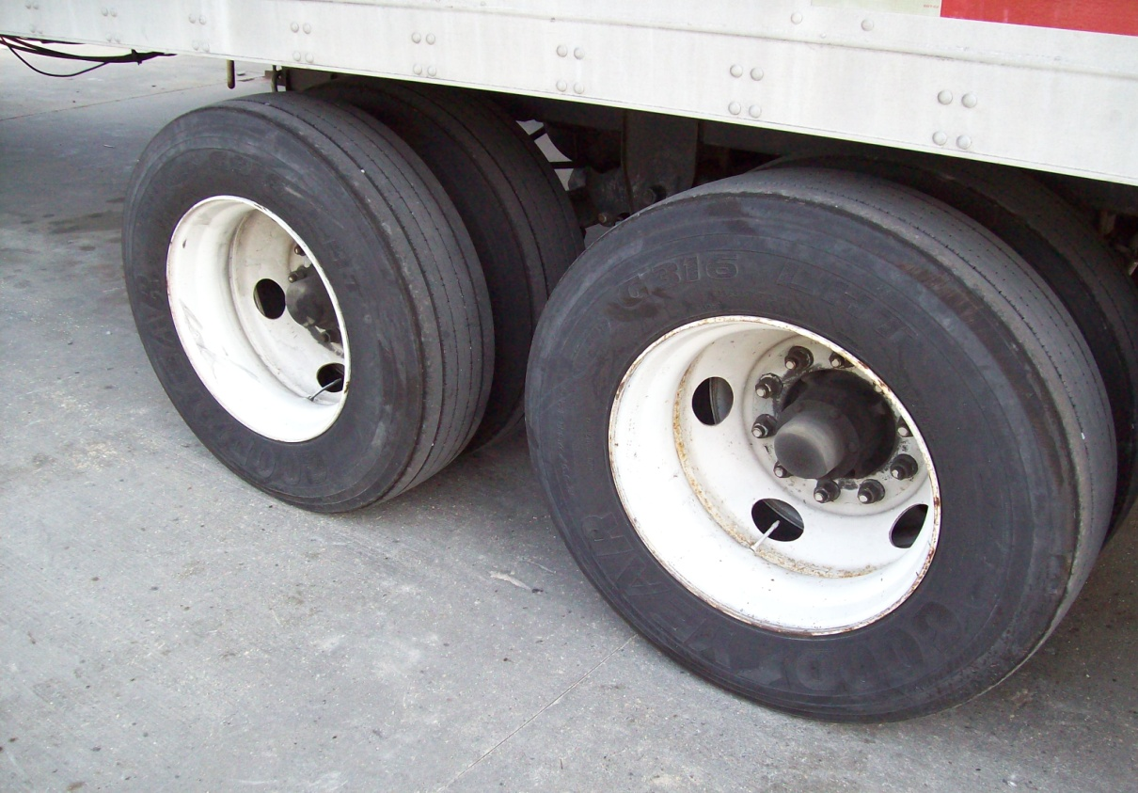
Step # 23
Check Rear Axle Same Way As Front
Note : This is now optional

Slide 39
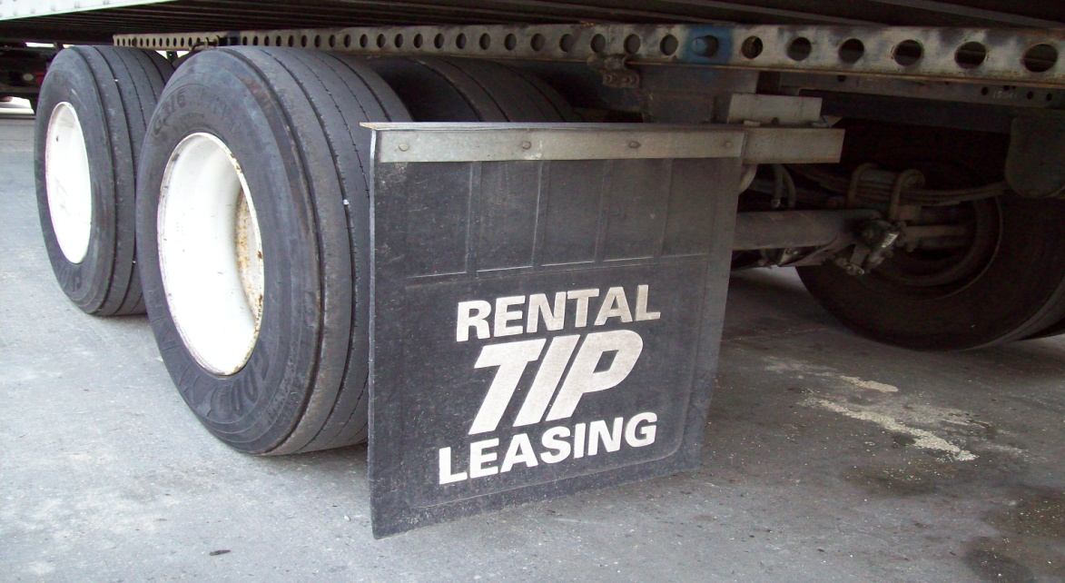

Step # 24
Rear Side of Trailer
Splash Guards
  Hangers tight and secure
  Splash guards in good condition
  Guards should be hanging less than 6” from ground
ABS and rear Clearance Lights
  Anti – Lock Brake Service Light secure lens not cracked or missing
  Rear clearance light secure lens not cracked or broken

Slide 40

Step # 25
Rear of Trailer
Tail / License Plate Lights
  Lights in place no cracked or broken lens
ICC Bumper / License Plate
  Secure no missing hardware

Slide 41

Step # 26
Right Side Of Truck
At this point you have to decide how to check the right side. If it is the same, you can say you would check it the same way as you checked the left side. If there is any differences you will only have to explain them and how you would check them. Example: side doors on a refrigerated trailer.
Note : You are now finished outside the truck

Slide 42

Step # 27
All Lights
Climb in the truck and put the key in the ignition switch, turn both light switches on. Close the door and roll the window down. Do not crank the engine. You will have to yell out the window as you run through the different lights. The examiner will check the lights for you starting at the rear of the truck.
Rear of Truck
  Clearance / Running
  Left turn
  Right turn
  Hazard
  Brake
Front of Truck
  Clearance / Running
  Left turn
  Right turn
  Hazard
  High / Low beam Headlights

Slide 43
Engine Start Procedure
Clutch Down
Foot Brake Covered
Gear Shifter in Neutral
Parking Brake Valves Out
Seat Belt On
Start Engine

Slide 44


Step # 28
Cab Controls
Note : At this point the examiner will get in the truck. Start the engine and let it idle.
Air Horn
  Activate horn
  Horn should work properly
Electric Horn
  Activate horn
  Horn should work properly

Slide 45



Step # 29
Windshield / Mirrors
Windshield
  Clean, not cracked, no sign of leaks
Mirrors
  Set properly, not cracked or broken

Slide 46


Step # 30
Gauges V. O. A. Plus Temperature
Volt / Temperature Gauges
  Battery voltage should be between 13 and 14.5 volts
Oil Pressure Gauge
  At idle pressure should be above 10 P. S. I.

Slide 47

Step # 30
Gauges V. O. A.
Air Pressure Gauge ( Primary & Secondary )
  Primary & secondary pressure should max. out around 120 P.S.I.

Slide 48

Step # 31
Heater & Brake Valves
Heater / AC Control Panel
  (Demonstrate operational controls) Fan Switch, Air Directional Switch, Temp. Control Switch, Compressor Control Switch, Air Intake Switch
Brake Valves
  (Yellow) Tractor Parking Brake Valve. Valve – out tractor parking brakes applied. Valve – in tractor parking brakes released.
  (Red) Trailer Air Supply Valve. Valve – out no air to the trailer, parking brakes applied. Valve – in air supplied to trailer, parking brakes released.
Note :
  Some older tractors had a third brake valve. This valve (blue in color) worked as a tractor brake valve and had to be in with the yellow valve to release tractor parking brakes
  Trailers built before 1975 may not have factory parking brakes
  Never Use Trailer Supply Valve as a Parking Brake

Slide 49


Step # 32
Turn Signal / Windshield Wiper Switches
Windshield Wiper
  Turn windshield wipers on and check switch in all positions. Check condition of windshield wipers as they work.
  Check windshield washer fluid
Turn Signal
  Turn left and right signals on check indicator lights for operation.

Slide 50

Step # 33
Seat & Seat Belt
All seat controls work properly
Seat belt works properly

Slide 51

Step # 34
Tractor Parking Brake Test
Test Procedure : (Engine should still be running) Push the Trailer Air Supply Valve (RED) in. This will release the trailer brakes. Leave the yellow valve out. Select a forward gear (Not Lower Than 4th ), slowly release the clutch to the friction point. Do not choke the truck off. It should loose only a few R.P.M’s. Truck should not move. Put the truck back in neutral. Tractor parking brakes working properly.
Push yellow valve in to release the tractor brakes. Put gearshift in 4th gear and release clutch to friction point. Let truck take off and apply brake pedal. Service brakes should hold. Tractor service brakes working properly.
Note : You must maintain a minimum of 90 P.S.I. in both primary and secondary gauges before you can continue.

Slide 52


Step # 35
Indicator Lights / Steering Wheel Play
Warning Indicator Lights
  Turn engine off
  Turn key switch back on, but do not start the engine.
  All indicator lights should come on and go off in 5 seconds if working properly.
Note :
  Leave the key switch in the on position to finish the pre – trip inspection
Steering Wheel
  2” play in a 20“ steering wheel

Slide 53

Step # 36
Air Brake Test L. A. B.
Note : Key switch should be on, engine not running, both brake valves in, 90 P.S.I. in primary and secondary gauges.
( L ) Brake Leak Down
  Push brake pedal down and let air pressure gauges level off. Hold pedal down for one minute, primary or secondary gauges should not fall more than 4 P.S.I. If not truck and trailer pass test.
( A ) Air Alarm System
  Pump brake pedal to let air out of system. Around 60 P.S.I. you should get a warning light and an audible alarm.
( B ) Parking Brakes
  Continue pumping brake pedal. When both primary and secondary gauges fall to around 30 P.S.I. both brake valves should pop out. Turn key switch off.
You Have Completed The Pre – Trip Inspection !

